Slide 1
2016 AAND & SDAMA
Bismarck ND
AIP Program Update
November 2016
Presented By: Laurie Suttmeier,
Deputy Manager, DMA-ADO

Slide 2
Presentation Overview
Status of FAA Re-Authorization
AIP Program for FY16
FY17 Dates to Remember
Considerations for a Good Season
Program & Guidance Updates

Slide 3
Status of FAA Re-Authorization & Appropriation
Authorization/Appropriation
Public Law 114-190, the “FAA Extension, Safety and Security Act of 2016” (the Extension) is through September 30, 2017 (our Authorization), and the Continuing Resolution through December 9, 2016 (our Appropriation). What does this mean?
Public Law 114-190 authorizes $3,350,000,000 in AIP funding authority for fiscal year (FY) 2017.
The Extension provides the authority to collect aviation taxes for deposit into the Airport and Airway Trust Fund (Trust Fund), and to expend money from the Trust Fund. Without these authorities, we could not operate.

Slide 4
Status of FAA Re-Authorization & Appropriation (Cont.)
As a result of this CR, FAA Office of Airports (ARP) is able to:
  continue to make payments on our 5000+ open grants.
  continue to provide uninterrupted oversight of our ARP programs at least through December 9, 2016
  The CR will keep all other FAA offices open and operational through December 9, 2016.
  The present CR provides $640m in funding, which is not enough to run our statutory formulas and distribute under AIP.

Slide 5
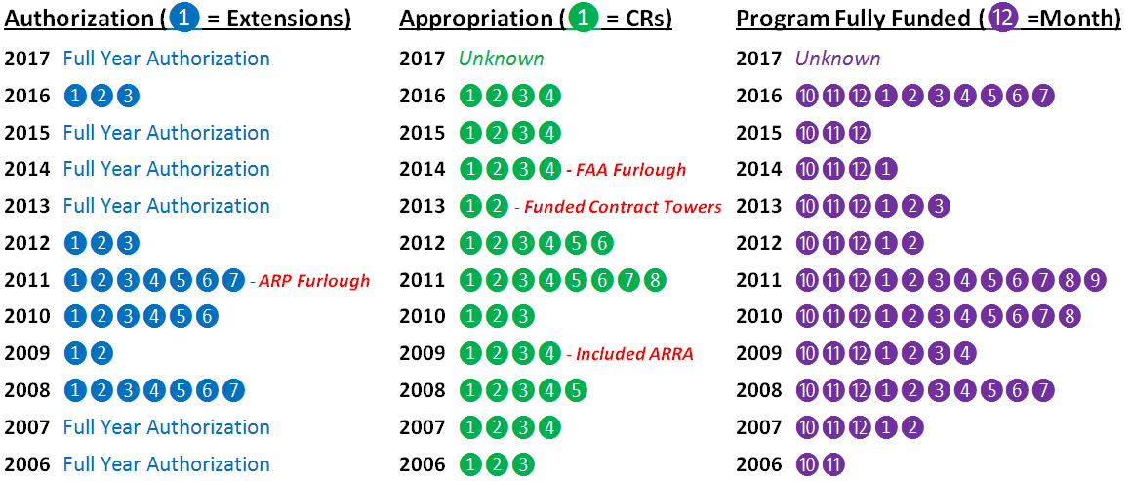

AIP Legislative History
Notes:
Blue = Authorization (number of extensions)
Green = Appropriations (number of continuing resolutions)
Purple = Month the program was fully funded (authorization and appropriation both extend to end of year).

Slide 6
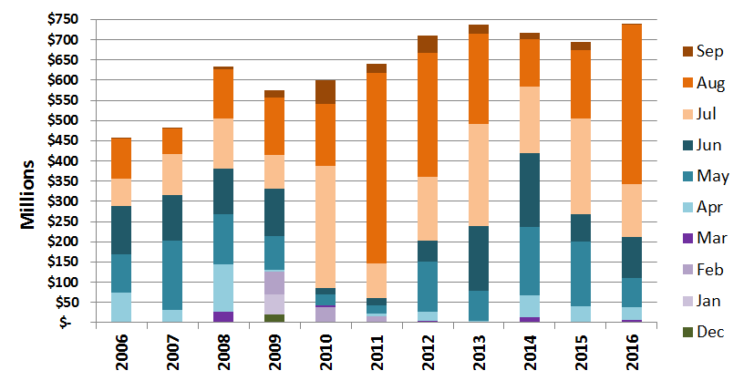
Historic AIP Carryover by Month
Notes:
Oranges = 4th quarter.
Blues = 3rd quarter.
Purples = 2nd quarter.
Green = 1st quarter.
In a perfect world, we wouldn’t have any…or at least very minimal…oranges (most everything carried over by July 1).
2011 was the worst year…7 authorization extensions, a furlough, and 8 continuing resolutions. Which brings us to our next slide.

Slide 7
FY 2012-2016 Funding Seasons
Fiscal Year | Compressed Grant Season? | Split Year? | When did the money become available?
2016 | YES | YES 3 Parts | Part A: February 16, 2016 Part B: March 7, 2016 Part C: July 28, 2016
2015 |  | NO | March 2, 2015
2014 |  | NO | March 4, 2014
2013 |  | YES 2 Parts | Part A: January 30, 2013 Part B: May 29, 2013
2012 |  | No | March 26, 2012

Slide 8
Project Timeline
Notes:
Andy to talk here about our continued vision for collaboration and our desire to help sponsors and consultants succeed.

Slide 9
Project Schedule
Sched |  | JAN | FEB | MAR | APR | MAY | JUN | JUL | AUG | SEP | OCT | NOV | DEC
Existing Schedule | Year 1 |  | Submit CIP for next FY |  |  |  |  |  |  |  |  |  | Pre-App Due Cat/Ex
 | Year 2 | SOW & Engs Design report | Airspace CSPP |  | Submit P&S |  | Bid Project | Open Bids | Transfer/ C.O. | Receive Grant
Proposed Schedule Option 1 | Year 1 |  | Submit CIP for next FY |  |  |  |  | Submit Cat-Ex | Submit SOW | Submit Pre-App | Submit Eng. Design Rpt |  | Airspace CSPP
 | Year 2 | Submit P&S |  | Bid Project | Open Bids | Receive Grant Transfer/ C.O.
Proposed Schedule Option 2 | Year 1 |  |  |  |  |  |  |  | ND CIP's Due | Pre-App Cat/Ex | Airspace CSPP |  | Submit SOW & Pre-App
 | Year 2 | Engs Design report |  | Submit P&S | Bid Project |  | Open Bids Transfer /C.O. Submit App. | Receive Grant

Slide 10

FY 17 AIP Important Dates
Dec 15: Pre-Application for due to FAA (with CSPP)
Jan 15th : Submit engineers design report to ADO
Jan 31st: Submit Safety Phasing Plans into airspace
Feb 28th: Submit CIP for FY18, FY19 & FY20
Mar 31st: Submit P&S (or 60 days before bidding)
May 1st : Transfer or carry-over NPE’s
July 1st : Grant Application due to FAA
Sep 1st: GOAL: All grant offers returned
  (Estimated date pending FRN to be issued)

Slide 11
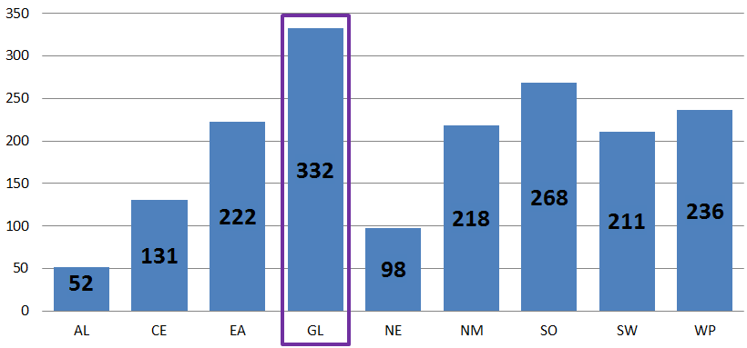
Number of FY16 New (Initial) AIP Grants
(National Summary)
Notes:
This does NOT include amendments, and therefore will not match the National Fund Status Report.
This includes current year available funds ONLY. It does NOT include future funding on multi-year grants.
SOURCE: Current Year Program Detail Report (SOAR)
FY16 was a challenging year as AIP funding became available in 3 parts (February, March & July).
During FY16, AGL Office of Airports issued 332 new AIP grants totaling approximately $575m in new AIP funds.
AGL issued more grants than any Region in the country.
AGL issued the 2nd most, in terms of total AIP dollars, of any Region in the US.
All projects on our discretionary list were funded in FY16

Slide 12
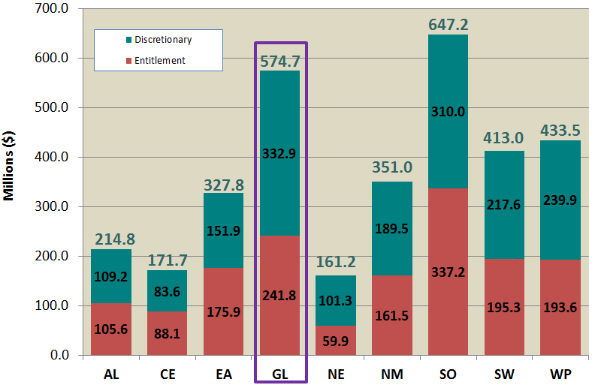
AIP Funding for ALL FY16 Grants Initiated
(National Summary)
Notes:
This does NOT include amendments, and therefore will not match the National Fund Status Report.
This includes current year available funds ONLY. It does NOT include future funding on multi-year grants.
SOURCE: Current Year Program Detail Report (SOAR)

Slide 13
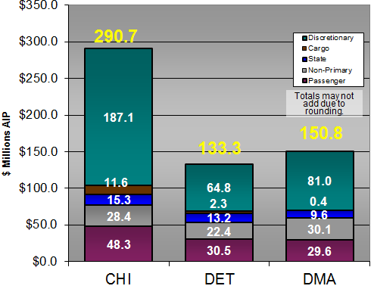
AIP Funding for ALL Grants Initiated in FY16
Notes:
Andy to talk here on how the three ADO’s compare, also mention historic funding levels.

Slide 14
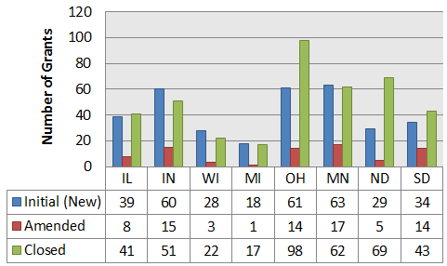
Types of Grants Programmed FY16
Notes:
Laurie to talk here on the focused effort of the Bismarck office to close out grants in FY15, we lead all ADO’s
NEW: 126
Closed: 174

Slide 15
Considerations for a Good AIP Season in FY17
The exact timing of funding for FY17 is an unknown at the moment.
A significant amount of our discretionary funds are obtained from carryover of entitlement projects.
If an Airport Sponsor knows early in the year that they are going to be rolling over their entitlements for FY17, please let the FAA know early. This allows us to carry this money over and distribute it as part of a discretionary project for another airport.
While we do what we can to accommodate Entitlement Only/State apportionment only projects that are bid late in the season, we really do encourage Sponsors to bid early to be able to provide funding as needed.

Slide 16
AIP Program Update
AIP Handbook – Change 1 – Publication in early 2017
PFC Order Rewrite – Internal/Industry Comments due Oct 31st
State Block Grant AC – Target publication for implementation is Oct 28th.

Slide 17
Planning Program Update
FAA Continues to Update Planning Guidance
  DRAFT AC 150/5050-4A – Community Involvement in Airport Planning (Formerly called “Citizen Participation in Airport Planning”) is out for industry comment. Comments are due November 8, 2016.
  DRAFT AC 150/5360-13A – Airport Terminal Planning & Design. It was distributed to industry for comment in July and the comment period closed near the end of August. FAA is reviewing comments.
  DRAFT AC 150/5000-XX – Critical Aircraft and Regular Use Determination – FAA is reviewing.

Slide 18
Compliance Program Update
Compliance published 3 policy documents in FY16
  Policy Concerning Flying Club Operations at Federally Obligated Airports – March 15, 2016
  Policy on Evaluating Disputed Changes of Sponsorship – June 6, 2016
  Policy on the Non-Aeronautical Use of Airport Hangars – Published on June 15, 2016; effective July 1, 2017.

Slide 19


Thank You!
Laurie J. Suttmeier
Deputy Manager Dakota-Minnesota ADO, Bismarck
FAA Great Lakes Region – Airports
2301 University Dr., Bldg 23B| Bismarck ND 58504
(701) 323-7381 | laurie.suttmeier@faa.gov

