Slide 1
Use of Hangars at Obligated Airports
Presented By:
Don Phillips
DMA-Bismarck Office
November 2, 2016

Slide 2
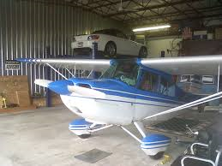
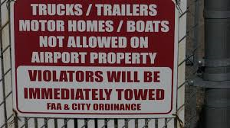

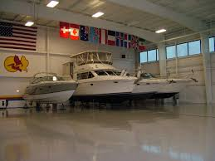

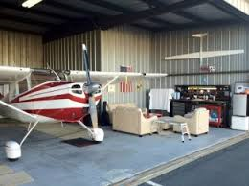
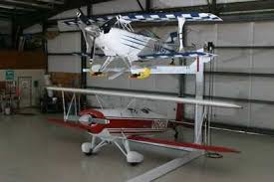
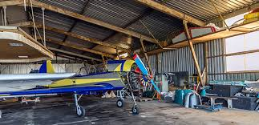
Hangar Use Policy
FAA Policy on the Non-Aeronautical Use of Airport Hangars – FRN 6/15/2016
Notes:
When the FAA announced in 2014 that it would be introducing new hangar-use regulations at grant-assured airports, many hangar tenants viewed the rulemaking process with suspicion, concerned that they would be forced to dispose of comforts of home such as refrigerators, barbeque grills, pin-ups and lawn chairs.

Slide 3
Background
July 22, 2014 – FAA issued a proposed statement of policy on hangar use in the FRN.
Received more than 2,400 comments
Comments objecting to the proposal tended to fall into 2 general categories:
  FAA should not regulate the use of hangars at all.
  The proposed policy is too restrictive in defining what activities should be allowed.

Slide 4


Back to the drawing board.

Slide 5
New Proposed Policy
Purpose: to provide clear and standardized guide for sponsors and FAA compliance staff.
The FAA has adopted a commonsense approach.
The primary focus of the new policy is to ensure the availability of hangars for aviation needs at airports funded by federal grants.
Notes:
However, the FAA acknowledges that there are periods of low hangar occupancy, during which airport sponsors can earn some income by renting out hangars for non-aviation activities.

Slide 6
Why are hangars limited to certain kinds of use?
If hangars are not reserved for aeronautical use, federal airport grant funds could inadvertently subsidize non-aeronautical users, and aeronautical users could be denied access to needed airport facilities.
Airport sponsors are obligated to use dedicated aviation facilities for aeronautical use.

Slide 7
AIP grant assurances that can apply to hangar use include:
Preserving rights and powers (GA 5)
Making the airport available for aviation use on certain terms (GA 22)
Not granting exclusive rights (GA 23)
Ensuring safe operations (GA 19)
Complying with the ALP (Airport Layout Plan) process and requirements (GA 29).

Slide 8
To assure appropriate use of hangars, an airport sponsor should:
Manage the use of hangars through an airport leasing program that requires a written lease agreement or permit;
Monitor the use of hangars on the airport and take steps to prevent unapproved non-aeronautical use;
Ensure that the length of time on a waiting list of those in need of a hangar for aircraft storage is minimized; and
In cases where temporary non-aero use of a vacant hangar is permitted, ensure that non-aviation users pay a fair market rental for the use of the hangar, and that the hangar can be returned to aviation use when needed.

Slide 9
What is the primary purpose of an aircraft hangar?
The primary purpose of an aircraft hangar is aircraft storage. If a hangar is serving its primary purpose, the storage of aircraft, then storage of non-aeronautical items in the hangar does not violate the airport sponsor's federal obligations.

Slide 10
Why is the FAA issuing a separate policy statement on hangar use?
The FAA had received a number of questions from airport sponsors and airport tenants about the possible uses of hangars, and about how rigidly the aeronautical use requirement should be applied.
In developing the policy statement, the FAA focused on giving discretion to the local airport sponsor and allowing reasonable accommodation of activities that do not impact other aeronautical uses and do not create unjustly discriminatory conditions at the airport.

Slide 11
To what airport facilities does the policy apply?
The policy applies to all aircraft storage areas or facilities on a federally obligated airport that are designated for aeronautical use on an FAA-approved Airport Layout Plan (ALP).
The policy does not apply to property designated for non-aeronautical use on an approved ALP or otherwise approved for non-aeronautical use by the FAA.

Slide 12
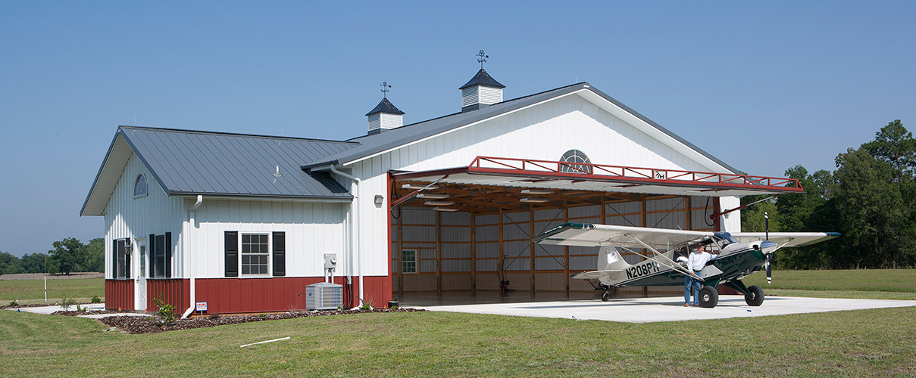
Does the policy apply to privately owned hangars on private property?
The policy does not apply to privately owned facilities located off the airport.

Slide 13
What aeronautical uses of a hangar does the FAA permit?
Storing active aircraft;
Sheltering aircraft for maintenance, repair, or refurbishment, but not indefinitely storing non-operational aircraft;
Constructing amateur-built or kit-built aircraft provided that activities are conducted safely

Slide 14
Permitted uses continued:
Storing aircraft handling equipment, e.g., tow bar, glider tow equipment, workbenches, tools and materials used to service, maintain, repair or outfit aircraft;
Storing materials related to an aeronautical activity, e.g., balloon and skydiving equipment, office equipment, teaching tools

Slide 15
Permitted use continued:
Storing non-aeronautical items that do not interfere with the primary aeronautical purpose of the hangar, e.g., televisions and furniture;
Parking a vehicle in the hangar while the aircraft usually stored in that hangar is flying, subject to local airport rules and regulations.

Slide 16
Uses not permitted:
Use as a residence;
Operation of a non-aeronautical business, e.g., limo service, car and motorcycle storage, storage of inventory, and non-aeronautical business office;
Activities that impede the movement of the aircraft in and out of the hangar;
Storage of fuel and other dangerous and Hazmat materials;

Slide 17
Uses not permitted:
Activities that displace the aeronautical contents of the hangar or impede access to aircraft or other aeronautical contents of the hangar;
Storage of household items that could be stored in commercial storage facilities;
Long-term storage of derelict aircraft and parts;
Storage of items or activities prohibited by local or state law;

Slide 18
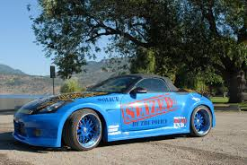

Uses not permitted:
Storage of inventory or equipment supporting a municipal agency function unrelated to the aeronautical use.

Slide 19
What are the policy changes for homebuilders?
The FAA understands the substantial convenience to aircraft builders of locating the entire aircraft construction process at the same location.
The new policy offers protections that never existed in the FAA's prior policy.

Slide 20
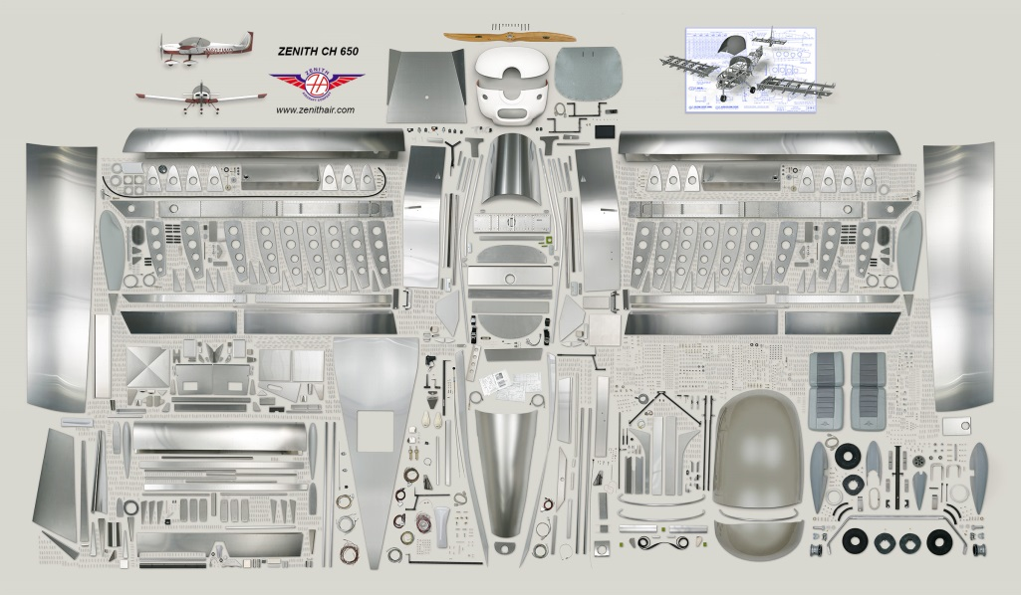
What are the policy changes for homebuilders?
First, the FAA recognizes amateur-built aircraft construction as an aeronautical activity to be accommodated at airports on reasonable terms, without unjust discrimination and without granting an exclusive right.

Slide 21
What are the policy changes for homebuilders?
Second, the new policy provides for the safe construction of amateur-built aircraft in hangars.
As an airport asset management tool, an airport sponsor leasing a vacant hangar for amateur-built aircraft construction may incorporate progress benchmarks in the lease to ensure the construction project proceeds to completion in a reasonable time.

Slide 22

Some aspects of aircraft construction may not be permissible in all hangars?
Some hangars may not have been designed to accommodate aircraft construction or all phases of aircraft construction. Airport sponsors have an obligation to mitigate inherent hazards in the operation, and to prevent unsafe conditions or practices.
For example, a sponsor could prohibit painting or other use of volatile or highly flammable materials in a hangar.

Slide 23
Does the policy apply to privately constructed hangars on federally obligated airports?
An airport sponsor's permission to lease aeronautical land on the airport for construction of a hangar accepts the sponsor's conditions that come with that land, in return for the special benefits of the location.

Slide 24
The fact that the tenant uses the land through a ground lease with the airport sponsor and constructs the hangar using tenant funds does not affect the airport sponsor's agreement with the FAA.
That agreement requires the airport land and facilities, including aircraft hangars, to be used for aeronautical purposes.

Slide 25
How does the use of a hangar affect the rent charged?
If a hangar is being used for an aeronautical use, the airport sponsor will generally charge the tenant the airport's standard rate for aeronautical leases, which should recover the airport's costs but which may be less than fair market rent.
If the hangar is used for an interim non-aeronautical purpose, the sponsor must charge a fair market rent for the hangar.

Slide 26
If there is no unsatisfied aviation demand for hangars, can they be leased to generate revenue from non-aeronautical uses?
If a sponsor has empty aeronautical use hangars for which it has no current aeronautical demand, it may seek FAA approval to lease those hangars to non-aeronautical tenants in one of two ways.

Slide 27
Hangar Lease
Option 1. When a sponsor wants to lease aeronautical hangars to a tenant for an extended time period (usually 3 to 5 years), it can request FAA approval for interim non-aeronautical use of a hangar until there is demand for an aeronautical purpose. The sponsor must charge a fair market commercial rental rate for any hangar rental or use for non-aeronautical purposes.

Slide 28
Hangar Lease
Option 2. A sponsor may also request FAA approval of a leasing plan for the lease of vacant hangars for non-aeronautical use on a month-to-month basis. Once the sponsor receives initial FAA approval, it may lease the open space for consecutive 30-day periods without further approval. The sponsor must charge a fair market commercial rental rate for any hangar rental or use for non-aeronautical purposes.

Slide 29


Hangar Lease
Aeronautical use must receive priority and accommodation over non-aeronautical use, even if the rental rate would be higher for the non-aeronautical use.

Slide 30
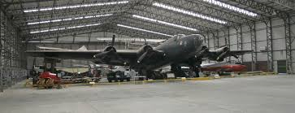
Aviation Museums and Non-Profits
Aviation museums and non-profit organizations that promote aviation should not be excluded from hangars:
  Aviation museums and non-profit aviation-related organizations may have access to airport property at less than FMV (Revenue Use Policy).
  There is no special reason for such activities to displace aircraft owners seeking hangar space for storage of operating aircraft, unless the activity itself involves use and storage of aircraft.

Slide 31
What discretion does the policy allow the airport sponsor?
Preserves the airport sponsor's discretion to manage or address issues
Provides protection against claims of discrimination by imposing consistent rules for incidental storage in all similar facilities at the airport;

Slide 32
Provides airport sponsors with the ability to permit certain non-aeronautical items to be stored in hangars provided the items do not interfere with the aeronautical use of the hangar;

Slide 33
Allows an airport sponsor to request FAA approval of an interim use of a hangar for non-aeronautical purposes for a period of 3 to 5 years; and
Allows an airport sponsor to request FAA approval of a leasing plan for the lease of vacant hangars for non-aeronautical use on a month-to-month basis.

Slide 34

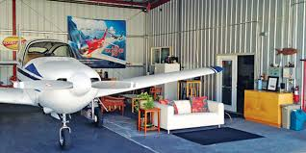
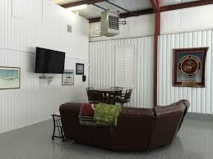
Policy Discussion
Allow some leisure spaces in a hangar, such as a lounge or seating area and kitchen, in recognition of the time many owners spend at the airport:
  The final policy does not include any special provisions for lounge areas or kitchens either permitting or prohibiting these areas.
  The policy requires that any non-aviation related items in a hangar not interfere in any way with the primary use of the hangar for aircraft storage and movement.

Slide 35
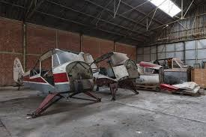
Policy Discussion
The time that an inoperable aircraft can be stored in a hangar should be clarified, because repairs can sometimes involve periods of inactivity:
  “Operational aircraft” does not necessarily mean an aircraft fueled and ready to fly.
  Aircraft experience downtime for maintenance and repair and for other routine and exceptional reasons.
  An airport operator should be able to determine whether a particular aircraft is likely to become operational in a reasonable time or not and incorporate provisions in the hangar lease to provide for either possibility.

Slide 36

Final Policy - Recap
Applies to all aircraft storage areas or facilities on a federally obligated airport unless designated for non-aeronautical use on an approved ALP or otherwise approved for non-aviation use by the FAA.

Slide 37
Final Policy - Recap
Hangars must be used for aeronautical purposes unless otherwise approved by FAA.
Aeronautical Uses for Hangars Include:
  Storage of active aircraft
  Final assembly of aircraft under construction
  Non-commercial construction of amateur-built or kit-built aircraft.
  Maintenance, repair, or refurbishment of aircraft, but not the indefinite storage of nonoperational aircraft.
  Storage of aircraft handling equipment, e.g., towbars, glider tow equipment, workbenches, and tools and materials used in the servicing, maintenance, repair or outfitting of aircraft.

Slide 38
Final Policy - Recap
Airport sponsors may permit non-aeronautical items to be stored in hangars provided the items don’t interfere with the aeronautical use of the hangar.

Slide 39
Final Policy - Recap
FAA will generally not consider items to interfere unless items:
  Impede the movement of the aircraft in and out of the hangar.
  Displace aeronautical contents of the hangar. A vehicle parked at the hangar while the vehicle owner is using the aircraft is not considered to displace the aircraft.
  Are used for the conduct of a non-aeronautical business or municipal agency function from the hangar.
  Are stored in violation of airport rules and regulations, lease provisions, building codes, or local ordinances.

Slide 40
Final Policy - Recap
Hangars may not be used as residences (limited exceptions)
FAA differentiates between typical pilot resting facility or aircrew quarters vs. hangar residence or hangar home.
Policy applies regardless of whether the hangar occupant leases the hangar from the airport sponsor or the hangar occupant constructed the hangar at their own expense while holding a ground lease.
Notes:
(limited exception for sponsors providing an on-airport residence for a full-time airport manager, watchman, or airport operations staff for remotely located airports.)
When land designated for aeronautical use is made available for construction of hangars, the hangars build on the land are subject to the sponsors obligations to use aeronautical facilities for aeronautical use.

Slide 41
Final Policy – Nonaeronautical Use
Sponsor is considered to have FAA approval for non-aeronautical use of a hangar in the following cases:
  FAA advance approval of an interim use;(3-5 years)
  FAA approval of a month-to-month leasing plan;
  Advance written release by the FAA for all other non-aeronautical uses of designated aeronautical facilities.
Notes:
Interim Use – may request approval for interim use of a hangar for non-aeronautical purposes for a period of 3 to 5 years…will review in accordance with Order 5190.6B. Lease terms should allow the hangars to be recovered on a 30 days’ notice for aeronautical purposes. Must charge FMV.
Month to Month – on next slide
All other – Chapter 22 in Order 5190.6B

Slide 42
Final Policy – Nonaeronautical Use
Advance approval of Month-to-Month Leasing Plan:
  Sponsor can obtain written approval for month-to-month leasing plan for non-aero use of vacant facilities from the ADO.
  The plan must provide for leases that include an enforceable provision for tenant to vacate on a 30-day notice.
  If sponsor receives a request for aero use and no other suitable space is available the sponsor will notify the month-to-month tenant to vacate.
  Required to charge non-aeronautical Fair Market Rental fees even on interim basis.

Slide 43
Final Policy – Nonaeronautical Use
Month-to-Month Leasing Plan request should include:
  Inventory of aeronautical and non-aeronautical land/uses;
  Information on vacancy rates;
  The sponsor’s procedures for accepting new requests for aeronautical use;
  Assurance that facilities can be returned to aeronautical use when there is renewed aeronautical demand for hangar space.

Slide 44

Final Policy – Construction of Aircraft
Non-Commercial construction of amateur-built or kit-built aircraft is considered an aeronautical activity.
No FAA approval required
Sponsors should consider incorporating construction progress targets in lease.
Notes:
Airport sponsors also should consider incorporating construction progress targets in the lease to ensure that the hangar will be used for final assembly and storage of an operational aircraft within a reasonable term after project start.

Slide 45
Final Policy – No Right to Non-Aeronautical Use
This policy allows some incidental storage of non-aeronautical items in hangars that don’t interfere with aeronautical use.
Policy neither creates nor constitutes a right to store non-aeronautical items in hangars.
Airport sponsor may restrict or prohibit storage of non-aeronautical items.
Notes:
Sponsors should consider factors such as emergency access, fire codes, security, insurance, and impact of vehicular traffic on their surface areas when enacting rules regarding hangar storage.
Sponsors should impose consistent rules for incidental storage in all similar facilities at the airport.
Sponsors should ensure that taxiways and runways are not used for the vehicular transport of such items to or from the hangars.

Slide 46
Final Policy – Sponsor Compliance Actions
Sponsors should have a program to routinely monitor use of hangars and take measures to eliminate and prevent unapproved non-aeronautical use of hangars.
Sponsors should ensure that length of time on a waiting list of those in need of a hangar for aircraft storage is minimized.

Slide 47
Final Policy – Sponsor Compliance Actions
Sponsors should consider including provisions in leases to adjust rental rates to FMV for any non-incidental non-aeronautical use of leased facilities.
FAA personnel conducting a land use or compliance inspection may request copy of the sponsor’s hangar use program.
Notes:
Include provisions for both Aero and non-aero leases.
In other words, if a tenant uses a hangar for a non-aeronautical purpose in violation of this policy, the rental payments due to the sponsor would automatically increase to a FMV level.

Slide 48

Final Policy – Final Thoughts
FAA may disapprove an AIP grant for hangar construction if there are existing hangars at the airport being used for non-aeronautical purposes.
Policy is effective July 1, 2017

Slide 49
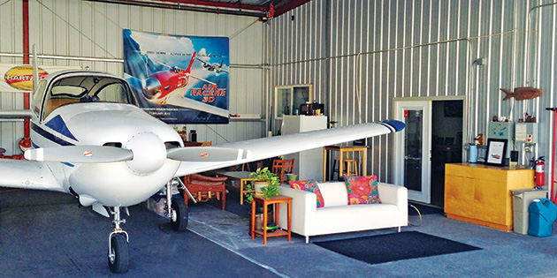
What do you think?

Slide 50
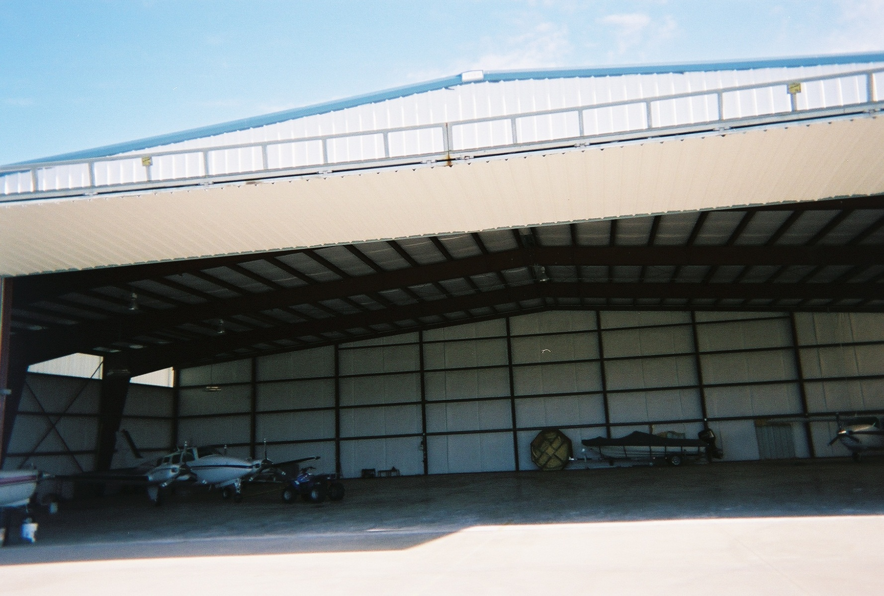
What do you think?

Slide 51
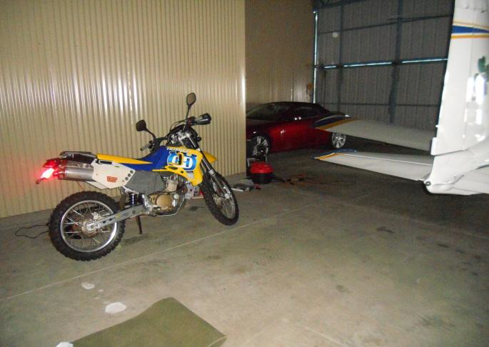
What do you think?

Slide 52
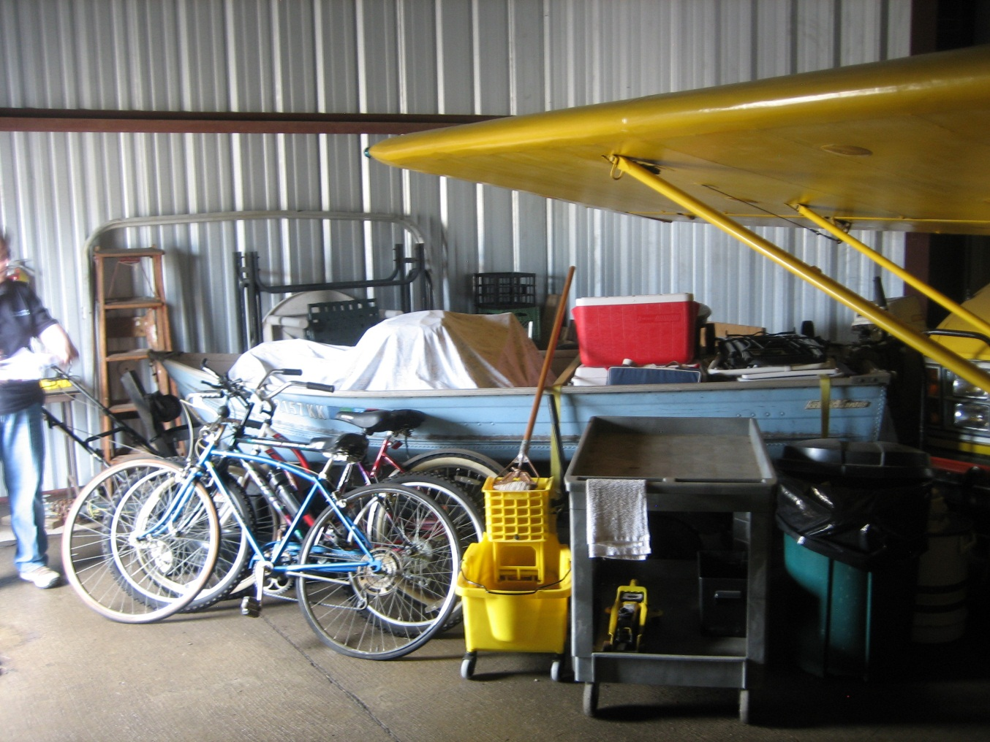
What do you think?

Slide 53
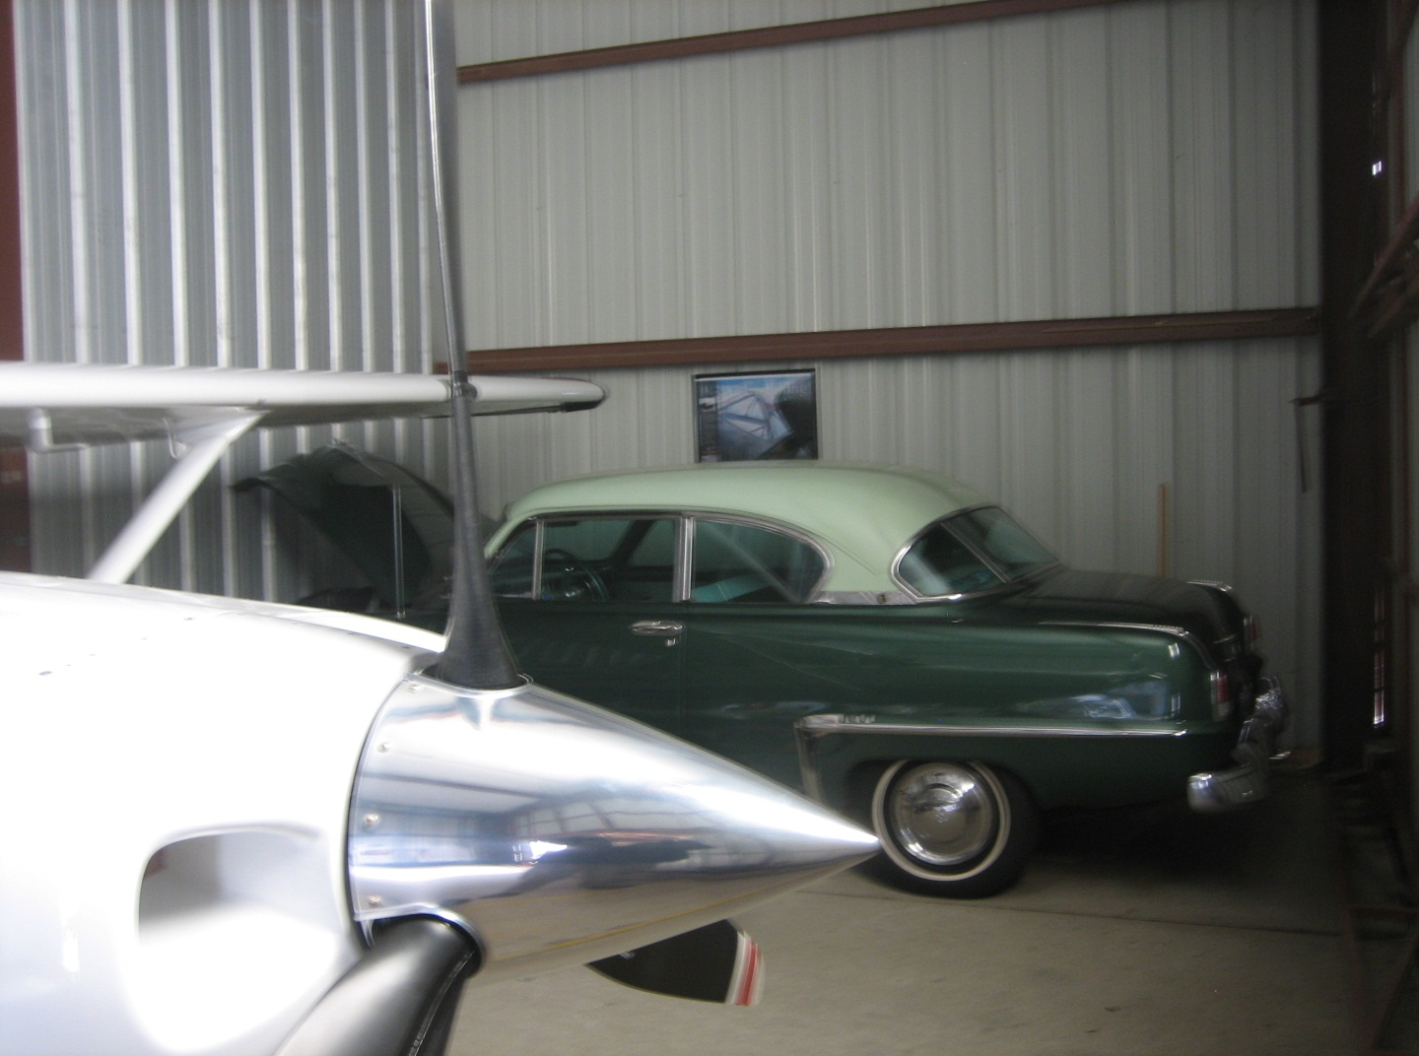
What do you think?

Slide 54
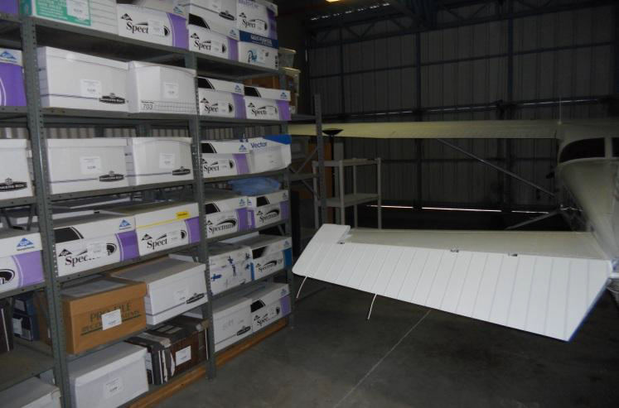
What do you think?
Notes:
No business storage, tough to see what’s in the front of the hangar

Slide 55
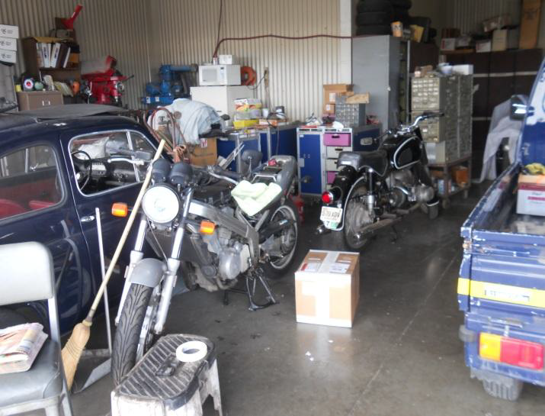
What do you think?

Slide 56
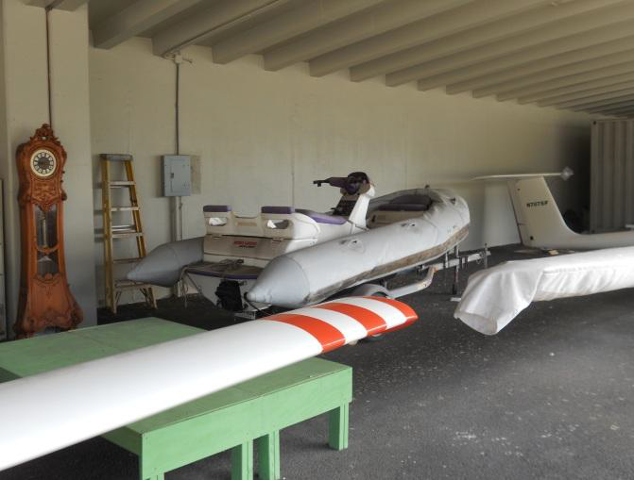
What do you think?

Slide 57
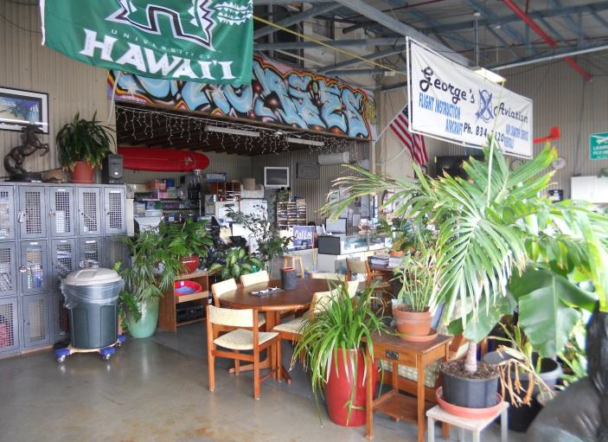
What do you think?

Slide 58

Questions

Slide 59
American Aviators are the Best
https://www.youtube.com/watch?v=u4D0yx4DvBk
https://youtu.be/u4D0yx4DvBk

