Slide 1
Modifying FAA Construction Specifications
Dakota FAA Consultants Workshop
Ryan Bale
November 2, 2016

Slide 2

Presentation Objectives
Describe the FAA’s role in reviewing Airport Sponsor’s construction specifications
Discuss the different ways to construct airports with federal funding
Describe the FAA’s expectations for modifying FAA standards
Modifying General Provisions
Notes:
Good afternoon everybody. Thank you for taking the time and listening in to this presentation.
My name is Carlton Lambiasi, Senior Civil Engineer for Airports Division in the FAA Great Lakes Regional Office. I am here to provide you with information and guidance on modifying FAA construction standards. The focus of this presentation is on modifying construction specifications as described in FAA Advisory Circular 150/5370-10 titled ““Standards for Specifying Construction of Airports”
First, we will look at the FAA’s role in reviewing Airport Sponsor’s construction specifications, next we will discuss the different ways to construct airports with federal funding, then we will learn the FAA’s expectations for modifying FAA standards and finally we will discuss modifying general provisions.
This GoToMeeting software enables users to manually input questions/comments, which will be made visible on my screen.
Before we get started, I would like to take a poll to gain a better understanding of my audience. You will see a poll appear on your screen asking who you represent. Please complete the poll. I will give users 1 minute to complete this. Thank you.

Slide 3
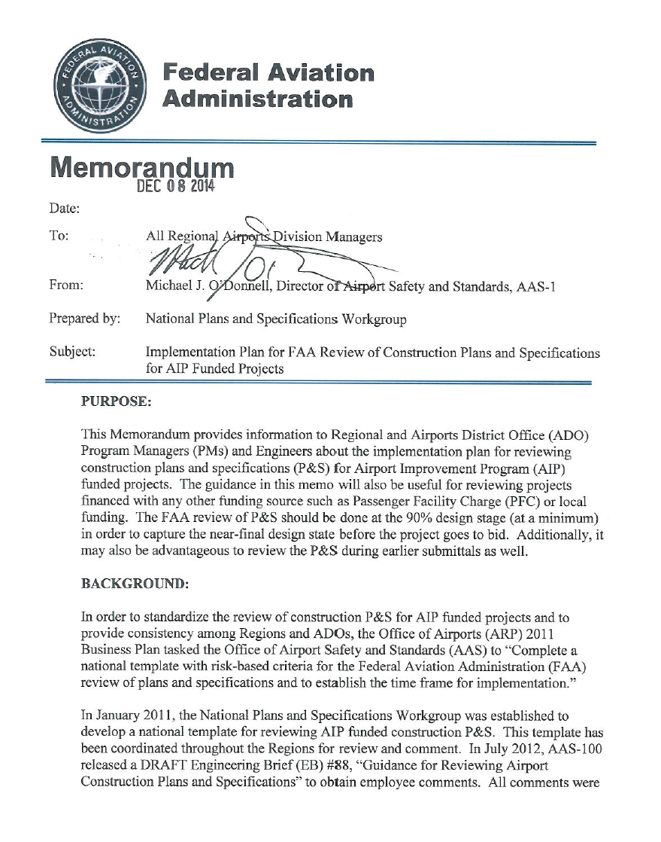
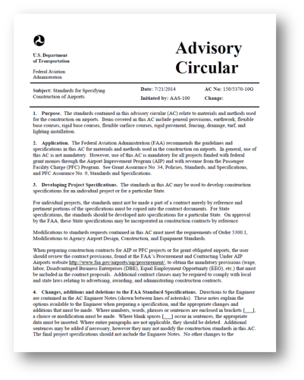
Plans & Specifications Review
“AC 150/5370-10 latest revision used and any modifications identified”
“Modification to Design Standards documented and approved”
Notes:
On December 8th 2014, the FAA Office of Airport Safety & Standards in Washington DC issued a memorandum which required the Airport District Offices to complete a review matrix when reviewing the airport sponsor’s plans and specifications for AIP funded projects. One of the primary purposes of this review is to ensure the project conforms to FAA construction standards. While reviewing the sponsor’s submittals, the ADOs will assess to ensure Advisory Circular 5370-10 is adhered to. Any unapproved modifications to the FAA’s construction standards will be forwarded to the Airport Sponsor for action. It is the FAA’s expectation for the Sponsor to resolve any concern prior to bidding their project.
At minimum, the FAA needs to review the plans and specifications at the 90% design stage. It may also be advantageous to submit plans at earlier stages so there are no surprises at the near-final design stage before the project goes to bid. Submitting complete plans and specifications along with any requests for modifying FAA specifications will help Airport Sponsors stay on the critical path and lessen the likelihood of project delay.

Slide 4

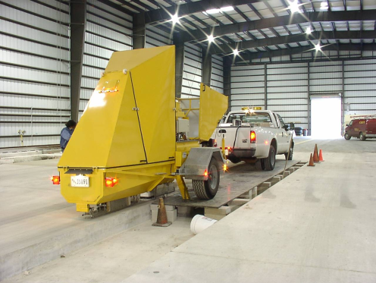


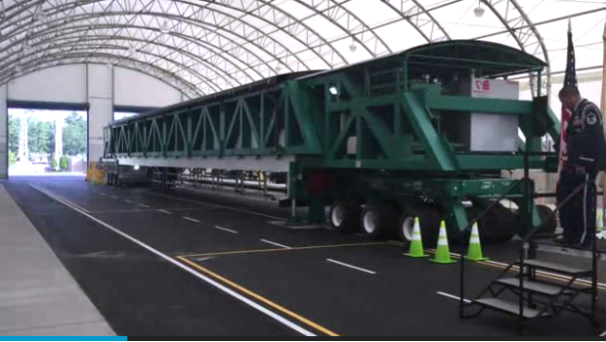
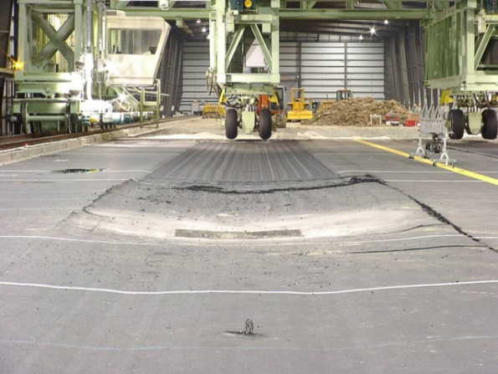
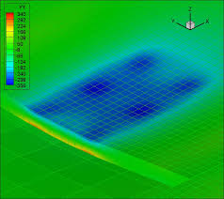
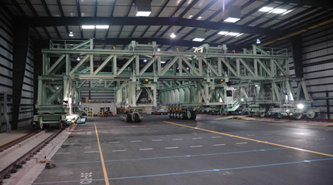


FAA AIRPORT TECHNOLOGY
RESEARCH & DEVELOPMENT BRANCH
Notes:
The FAA is strongly encouraging airports to construct their airfield pavements utilizing Advisory Circular 5370-10 without any changes. The FAA has developed construction standards and pavement design using failure models based on full-scale tests conducted since the 1940s. The FAA’s paving standards are the result of detailed airport-focused pavement research at the FAA’s William J. Hughes Technical Center located in Atlantic City. It has been developed in consultation and coordination with a broad section of external aviation stakeholders. The use of these standards allow consistency in construction and predictability for stakeholders using the system.
The FAA has recently dedicated a new research center at the Tech Center. A new National Airport Pavement and Materials Research Center allows engineers to use a custom-designed $4.2 million vehicle simulator to test pavement materials at very high tire pressures and temperatures.
While the FAA strongly encourages airports not to modify the construction specifications, we also comprehend there are situations where a modification to standard is necessary. Later in this presentation we will discuss the process in requesting a modification.

Slide 5

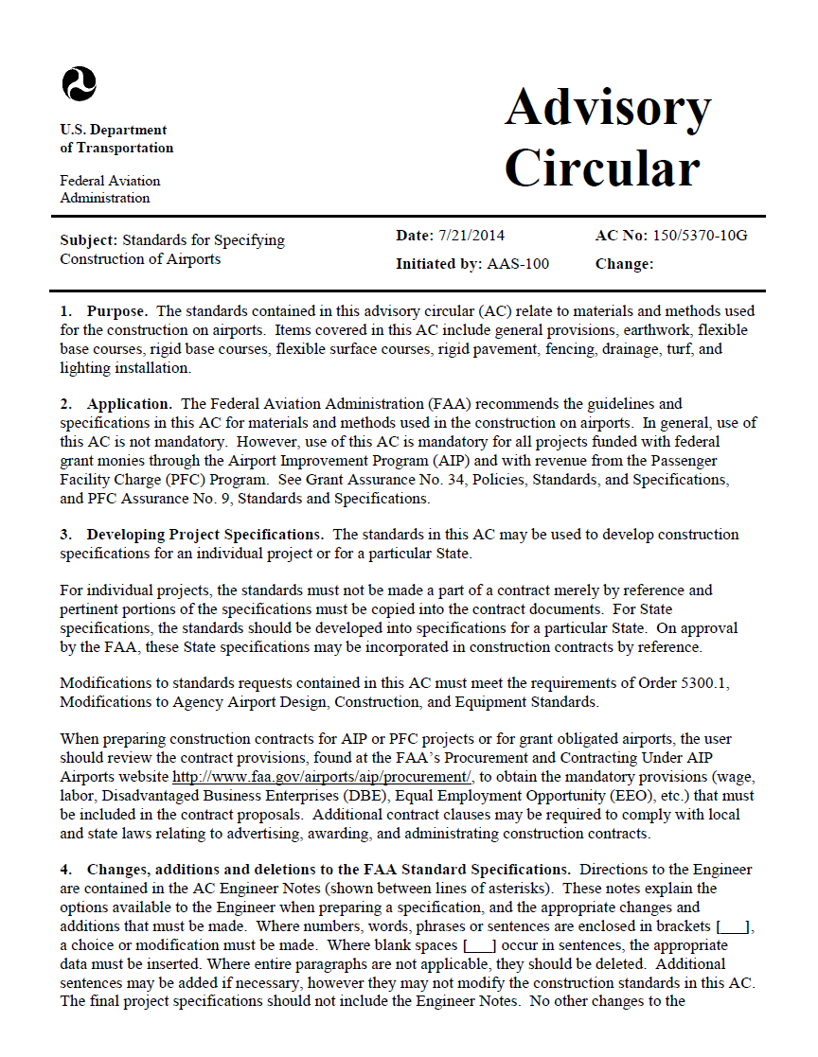
AC 150/5370-10G
Standards for materials and methods used for construction on airports.
  Earthwork
  Flexible base courses
  Rigid base courses
  Flexible surface courses
  Rigid pavement
  Fencing
  Drainage
  Turf
  Lighting Installation
Notes:
The subject Advisory Circular contain standards relating to materials and methods used for the construction on airports. Items covered include but is not limited to earthwork, flexible and rigid base courses, flexible and rigid surface courses, fencing, and drainage.
The use of this AC is not mandatory, however if your project is funded with federal grant monies (which includes AIP or PFC funds) it is required.
In addition, by accepting federal dollars Airport Sponsors are obligated under grant assurances (specifically #34 and PFC assurance #9) to carry out the project in accordance with policies, standards, and specifications approved by the FAA.
Projects that meet this Advisory Circular is always AIP eligible, it is only when it is modified and unapproved that it is at risk of being ineligible.
Airport Sponsors must understand the plans and specifications they are self-certifying, as they are the grant recipient. If projects are later determined ineligible, it is them who is not complying with the statutory requirements.
In regards to proposed standards that exceed those of the FAA, the FAA’s policy is that if the project meets the prescribed standards, then the public need has been fully met. For example, an Airport Sponsor proposing additional ASTM testing on test specimens. Except in limited circumstances, any work exceeding FAA standards is not AIP eligible. The Sponsor has the option of paying for the cost to exceed the FAA standards, as long as they are meeting federal procurement requirements for inclusion of ineligible and/or non-AIP work in a contract. Please refer to the AIP Handbook for additional information on this.

Slide 6

4 Methods to Construct with Federal Funds
FAA Specification
I.A.W. AC 150/5370-10
FAA Approved Modified Specification
I.A.W. FAA Order 5300.1F
FAA Approved State Highway Spec.
I.A.W. 49 U.S. Code § 47114
FAA Approved State Standard
I.A.W. 49 U.S. Code § 47105
Notes:
The FAA recognizes 4 methods to specify construction on airports while using federal funds. These include…
#1 – Utilizing the FAA Construction Specification, verbatim, in accordance with AC 5370-10.
#2 – Requesting and receiving FAA approval for a modified specification in accordance with FAA Order 5300.1F.
#3 – Utilizing a FAA approved State Highway Specification, in accordance with US Code 47114.
#4 – Utilizing a FAA approved State Standard, in accordance with US Code 47105.

Slide 7
4 Ways to Construct with Federal Funds
FAA Specification
I.A.W. AC 150/5370-10
FAA Approved Modified Specification
I.A.W. FAA Order 5300.1F
FAA Approved State Highway Spec.
I.A.W. 49 U.S. Code § 47114
FAA Approved State Standard
I.A.W. 49 U.S. Code § 47105
Notes:
Since the first method is self explanatory, we will skip to the 2nd one. Constructing pavement by modifying FAA specifications in accordance with FAA Order 5300.1F.

Slide 8
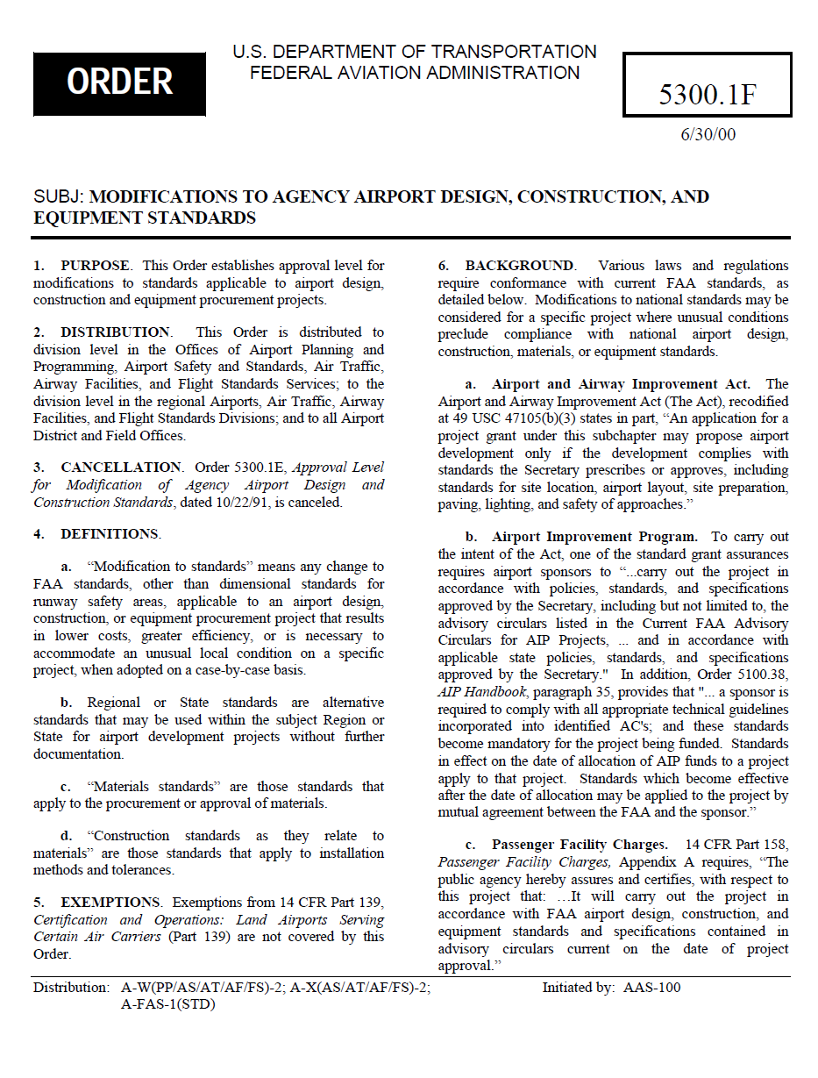
FAA Approved Modified Specification
I.A.W. FAA Order 5300.1F
Modifications to materials standards shall be made only when locally available materials cannot meet the requirements of that standard…”
Modifications to construction methods standards shall be made only when they will result in cost savings and/or greater efficiency,…
Modifications to the general provisions of AC 150/5370-10, Standards for Specifying Construction of Airports, permitted to ensure conformance with local laws and regulations.
Notes:
Order 5300.1F is the current internal FAA policy on modifications to standards applicable to airport design, construction and equipment procurement projects. Relating to construction projects, the policy states…
Modifications to materials standards shall be made only when locally available materials cannot meet the requirements of that standard. The FAA does not define “locally” and does not set a distance relating to the project site. If the Airport Sponsor elects to submit a MOS under this provision, it is expected that the airport sponsor provide the nearest location that is able to provide materials meeting the FAA standards and reasons why that source is not practicable for the project. In addition, the Airport Sponsor must provide specifications on the new modified materials and assurance that the material will provide a product that will meet FAA standards for acceptance and that the finished product will perform for its intended design life, based on historical data.
Modifications to construction methods standards shall be made only when they will result in cost savings and/or greater efficiency without sacrificing safety or useful life. An example of this is an Airport Sponsor proposing to rubbilize existing Portland Cement Concrete pavement for use as an aggregate base course. What this does NOT mean, is removing acceptance criteria testing from the FAA specification to reduce project costs.
Modifications to the general provisions of AC 5370-10 is permitted to ensure conformance with local laws and regulations. Much of the general provisions ensures conformity to CFR Part 200 (formerly CFR 18.36), current legislation and policy described in the AIP Handbook, and most importantly protects the best interest of the Airport Sponsor. Unknowingly, modifying the general provisions can result in the Airport Sponsor accepting liability from the contractor. In these situations, AIP will not participate in costs associated with corrective actions.

Slide 9

Requests to Modify Quality Control
Quality control criteria include all the tests performed to determine if adjustments to operations are necessary to stay within specification limits.
Acceptance testing includes all criteria and the tests performed to determine acceptability of the material or finished product.
Notes:
Requests to modify quality control criteria, including all performance tests to determine if adjustments to operations are necessary to stay within specification limits, must be approved by the FAA. This includes aggregate gradation within tolerance for subbase, base, and surface courses; asphalt content for bituminous mixes; and slump and air content for concrete mixes.
Requests to modify acceptance criteria, including all criteria and performance tests to determine acceptability of the material or finished product, must be approved by the FAA. This includes density and thickness for subgrade, subbase, base courses, and bituminous pavement; flexural strength and thickness for concrete pavement; and surface tolerances for subbase, base, and surface courses.
Testing requirements outlined in Advisory Circular 5370-10 provides assurance that the pavement constructed in the field is within the FAA’s acceptable tolerance which ultimately assures the 20 year structural life is met.

Slide 10

Changes, Additions and Deletions to the FAA Standard Specifications.
Directions to the Engineer are contained in the AC Engineer Notes
Engineer Notes explain the options available to the Engineer
Final project specifications are not to include the Engineer Notes
Where entire paragraphs are not applicable, they should be deleted.
Additional sentences may be added if necessary, however they may not modify the construction standards in this AC.
No other changes permitted, unless the Engineer has received the approval of the FAA.
Notes:
There are some changes permitted in Advisory Circular 5370-10 that does not require a modification to standard request. These items are discussed on the first page of the Advisory Circular.
Directions to the Engineer are contained in the Engineer Notes section (which are shown between lines of asterisks).
These notes explain the options available to the Engineer when preparing a specification, and the appropriate changes and additions that must be made.
Where numbers, words, phrases or sentences are enclosed in brackets [ ], a choice or modification must be made.
Where blank spaces [ ] occur in sentences, the appropriate data must be inserted.
Where entire paragraphs are not applicable, they should be deleted.
Additional sentences may be added if necessary, however they may not modify the construction standards in this AC.
No other changes to the specification may be made unless the Engineer has received the approval by the FAA

Slide 11


Minimum Requirements Prior to FAA Review
  Completed MOS form along with modified specification
  Airfield map clearly depicting locations.
  Reason for the MOS request
  Assurance that the MOS will provide a product that will meet FAA standards for acceptance and that the finished product will perform for its intended design life (historical data)
  FAARFIELD analysis when modifying materials.
  All referenced material must be provided in the MOS package
Notes:
In order for the FAA to review a modification request, there are certain items which would help expedite the review. Failure to provide these items may delay the review.
Completed modification to standard form along with modified specification. We will discuss this further in the upcoming slide.
Airfield map clearly depicting locations. For example, if you are modifying only half a parallel taxiway or only a portion of an apron then please provide a map that depicts this area.
Reason for the MOS request (is local material not available? Does the proposal result in cost savings?)
Assurance that the MOS will provide a product that will meet FAA standards for acceptance and that the finished product will perform for its intended design life. If historical data is available, please provide.
FAARFIELD analysis when modifying materials. The FAARFIELD program has set default values when using the FAA specification, however modifying materials may change its attributes. For example, if the airport sponsor is modifying the standard for bituminous base and changes the fixed modulus from 400,000 psi, we expect the FAARFIELD report to reflect the new modulus.
If the MOS submittal is referencing other documents, we expect all referenced material must be provided in the MOS package.

Slide 12
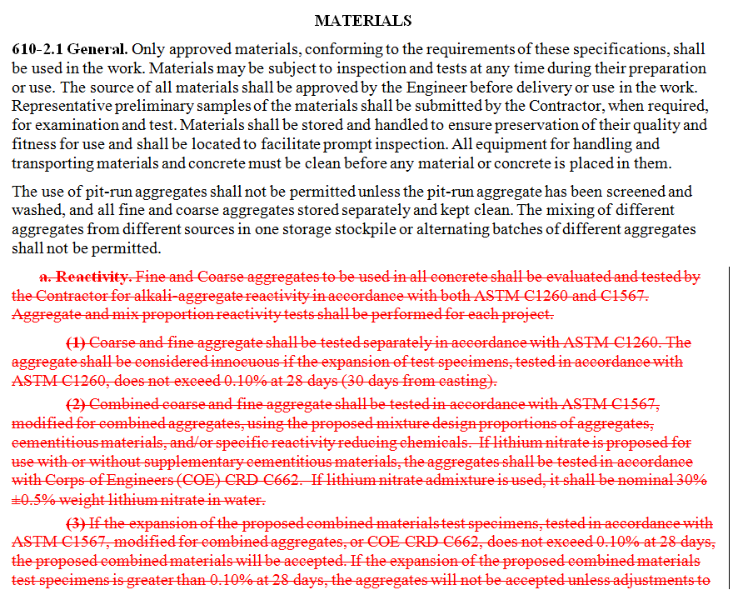


Utilize Track Changes
Track changes while you edit
Open the document that you want to revise.
On the Review tab, in the Tracking group, click the Track Changes button.
Make the changes that you want.
Notes:
The FAA has uploaded a Microsoft Word version of the Advisory Circular online, as we are requesting Airport Sponsors to submit track changes to the FAA so we have a clear understanding of what has been modified.
This will also expedite the FAA review process.

Slide 13
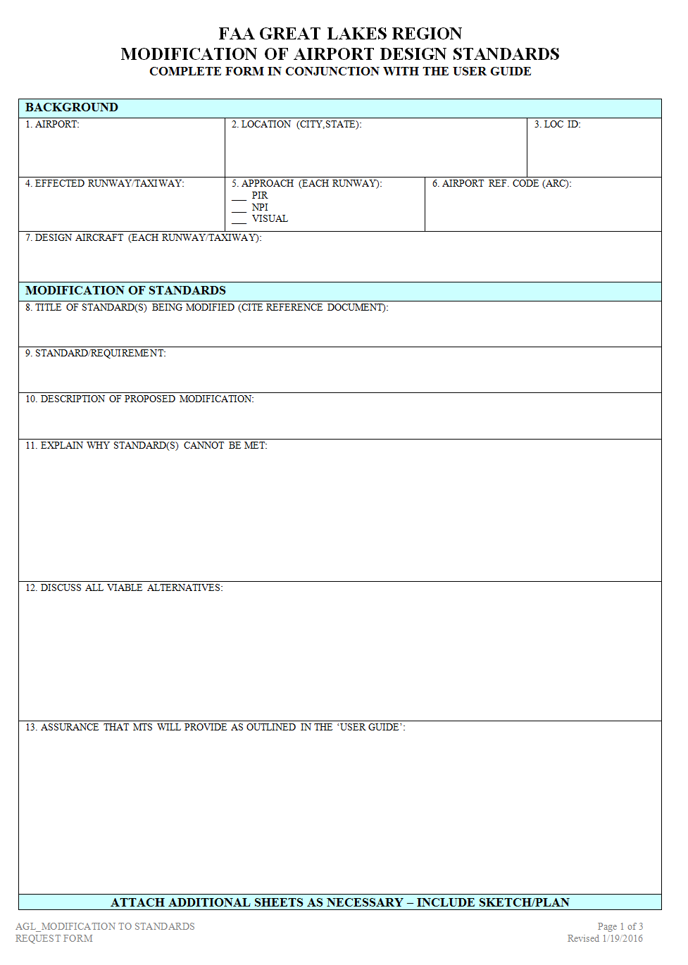
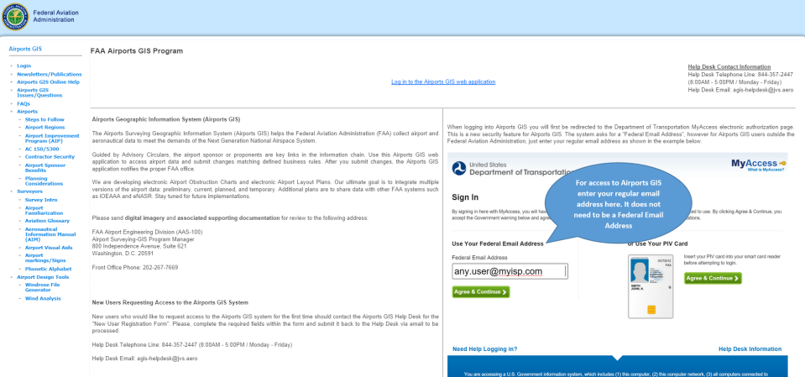
Submitting MOS Requests
TODAY
NEAR-FUTURE
http://www.faa.gov/airports/great_lakes/engineering/
https://airports-gis.faa.gov
Notes:
Airports-GIS has been updated with a modification to standard portal, which is currently under testing. The FAA does not have a confirmed date, however we anticipate sometime in Spring of this year.
Until this system goes live, please continue to use the modification to standard form which is available for download on the FAA’s Great Lakes Region website.
If an airport is requesting multiple modifications for the same project, the FAA expects to receive multiple requests.
For example; if an airport is proposing a modification to both the P-501 specification and P-209, the FAA expects to receive 2 separate requests.

Slide 14



Approval Authority
ADO
REGION
HQ’s
Notes:
Under current policy, all modification to construction standards are submitted to the ADO for initial review. It is then coordinated with the Regional Office, who forwards to Headquarters who has ultimate approval authority.
I am unable to tell you how long it takes for the FAA to review a modification request as there are numerous factors including the complexity of the submittal.
It is recommended that if the Airport Sponsor anticipates a modification request to incorporate this activity into the overall project plan.
A best practice would to submit a modification request well in advance of the 90% plans and specs submittal.

Slide 15
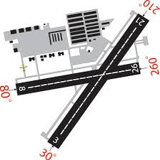

Clarification:
Prior Approval
MOS requests is AIP project specific. Receiving prior approval, does not relieve the Airport Sponsor in submitting future MOS.
FAA Approval in 2010 for Modifying P-209
Upcoming 2016 Project, requesting identical P-209 MOS [FAA Approval Required]
Notes:
Modification to standards requests is project specific. Receiving prior approval, does not relieve the Airport Sponsor in submitting future MOS requests.
For example, an airport who has received a 2010 approval for modifying P-209 is not permitted to use that approval for a 2016 project. The Airport must submit a new MOS for the 2016 project.
Approvals of Modifications of Construction Standards remain in effect for the life-cycle of the applicable project. The FAA does not allow changes to Modifications of Standards after approval, instead a new Modification of Standards request needs to be submitted by the Airport Sponsor if updates are necessary.

Slide 16

Clarification:
Signature Page
As the grant recipient, the Airport Sponsor is required to sign the modification to standard request, not their consulting firm.
Notes:
Modification to standards received that contains the consulting firms signature will automatically be rejected without further review. Airport Sponsors are the grant recipients, not the consulting firm, therefore the airport sponsor must sign the request and understand what they are signing.

Slide 17


Clarification:
Airport Access/Perimeter Roads
Roads that are not exposed to aircraft loads can be constructed using state highway specifications when funded with federal monies without submitting a modification to standards.
AIRPORT
OPERATIONS
Notes:
There has been confusion when it comes to airport roads that are not exposed to aircraft loads. These roads may be constructed using state highway specifications without submitting a modification to standards.

Slide 18
4 Ways to Construct with Federal Funds
FAA Specification
I.A.W. AC 150/5370-10
FAA Approved Modified Specification
I.A.W. FAA Order 5300.1F
FAA Approved State Highway Spec.
I.A.W. 49 U.S. Code § 47114
FAA Approved State Standard
I.A.W. 49 U.S. Code § 47105
Notes:
The third method is utilizing a FAA approved state highway specification in accordance with 49 US Code 47114.

Slide 19

49 U.S. Code § 47114 – Apportionments
(5) Use of state highway specifications.—
(A) In general.— The Secretary may permit the use of State highway specifications for airfield pavement construction using funds made available under this subsection at nonprimary airports with runways of 5,000 feet or shorter serving aircraft that do not exceed 60,000 pounds gross weight if the Secretary determines that—
  (i) safety will not be negatively affected; and
  (ii) the life of the pavement will not be shorter than it would be if constructed using Administration standards.
Notes:
US Code 47114 permits the use of state highway specifications for airfield pavement construction at non-primary airports with runways of 5,000 feet or shorter serving aircraft that does not exceed 60,000 pounds. This statute is not an automatic approval for airports to construct using state highway specifications, but rather a possible alternative. The FAA is responsible for determining that safety will not be negatively affected and the life of the pavement will not be shorter than it would be if constructed using FAA standards.

Slide 20
Modification Of Standards (MOS)
Modifications or Substitution of Pavement Specifications
TITLE 49 USC 47114 (d)(5)(A)
The Secretary may permit the use of State Highway Specifications for airfield pavement construction at non primary airports with runways 5,000 feet or shorter serving aircraft that do not exceed 60,000 pounds gross weight.
Clarification in 150/5370-10G and Errata Sheet (7/13/2015)
What does this mean?
> 60,000 lbs weight: No State materials, requires HQ approval
>12,500 lbs but < 60,000: MOS for State materials, requires Regional approval
<12,500 lbs: MOS for State DOT Specifications, requires ADO approval
Notes:
> 60,000 lbs weight: No State materials, MOS approval follow Order 5300.1 → MOS will be elevated to Regional and HQ Level after ADO review.
>12,500 lbs but < 60,000: MOS approval for State materials, follow Order 5300.1 → MOS will be elevated to Regional Level after ADO review.
<12,500 lbs: MOS approval for State DOT Specifications, Approval by ADO

Slide 21
Modification Of Standards (MOS)
Modifications or Substitution of Pavement Specifications
< 12,500 pounds gross weight
State Pavement Specifications (MOS may be approved at ADO)
Why local materials can not meet specification? (gradation or quality of materials)
Will methods be equal or better than FAA spec?
If substituting local material show where to be used in pavement structure, attach FAARFIELD design report.
Do Acceptance and Testing Criteria meet FAA requirements?
Notes:
State Pavement Specifications (MOS may be approved at ADO)
Why local materials can not meet specification? (gradation or quality of materials)
Will methods be equal or better than FAA spec?
If substituting local material show where to be used in pavement structure, attach FAARFIELD design report.
Does Acceptance Criteria meet FAA requirements?

Slide 22

Modification Of Standards (MOS)
Modifications or Substitution of Pavement Specifications
< 12,500 pounds gross weight
P-403 may be used in place of P-401
No PWL: Accepted or Remove & Replace
Density Requirements → Mat: 96% vs 96.3%, Joint: 94% vs 93.3%
P-403 averages density over each lot, no penalty for variations
Test Section is not required
Air Voids → No Acceptance Criteria
Following AC 150/5370-10 is ALWAYS AIP ELIGIBLE!

Slide 23
4 Ways to Construct with Federal Funds
FAA Specification
I.A.W. AC 150/5370-10
FAA Approved Modified Specification
I.A.W. FAA Order 5300.1F
FAA Approved State Highway Spec.
I.A.W. 49 U.S. Code § 47114
FAA Approved State Standard
I.A.W. 49 U.S. Code § 47105
Notes:
Finally, using a FAA approved state standard in accordance with 49 U.S. Code 47105.

Slide 24


49 U.S. Code § 47105 – Project Grant Applications
(c) State Standards for Airport Development.— The Secretary may approve standards that a State prescribes for airport development at nonprimary public-use airports in the State. On approval under this subsection, a State’s standards apply to the nonprimary public-use airports in the State instead of the comparable standards prescribed by the Secretary under subsection (b)(3) of this section. The Secretary, or the State with the approval of the Secretary, may revise standards approved under this subsection.
Notes:
US Code 47105 permits airports to use state aviation standards at nonprimary public use airports. The development of State aviation standards should begin with Advisory Circular 5370-10, and then modified by the State.
Unlike the previously mentioned US CODE there are no restrictions for runway length or gross weight for state aviation standards, however it only applies to non-primary airports.
Only the State Agency can submit for a State specification to the FAA. Upon approval, airport sponsors is able to utilize the state specification at non-primary airports.
When the FAA Construction Standards Advisory Circular is updated, the State Agency is required to update their aviation standard and resubmit to the FAA for approval.

Slide 25
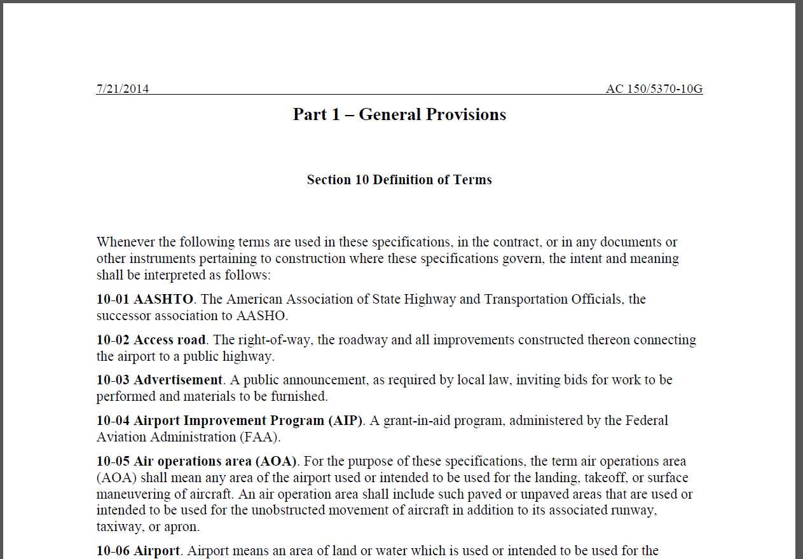
General Provisions
Notes:
The general provisions is Part 1 of the Advisory Circular. It goes through various items including but not limited to how the sponsor is to advertise to bidders, how the sponsor awards the contract, and conformity with plans and specifications. Much of the general provisions is a result of ensuring conformance to federal procurement rules (i.e. federal law) under CFR 200 and the AIP Handbook, but also ensures the federal investment is protected. As previously mentioned, altering the general provisions can shift liability from the contractor to the airport sponsor.
Federal procurement rules differ from one federal agency to another; for example the FAA and the Federal Highway Administration has a different procurement process.

Slide 26

“Modifications to the general provisions of AC 150/5370-10, Standards for Specifying Construction of Airports, should be made only to make them consistent with local laws and regulations.”
- FAA Order 5300.1F
Notes:
Order 5300.1F is the FAA’s policy for modifying agency airport design, construction, and equipment standards. The policy document says “Modifications to the general provisions of AC 150/5370-10, Standards for Specifying Construction of Airports, should be made only to make them consistent with local laws and regulations.”

Slide 27
Request to Modify General Provisions
Can be modified to meet State or local provisions, however does not relieve need to follow Federal Regulations
Must not change the intent
Changes due to local law/regulation permitted
Need to show modifications with track changes on for MOS submittal
May use FAA General Provisions and supplemental sections for local requirements as long as the FAA provisions govern. (No MOS submittal is required)
Notes:
Modifications of FAA General Provisions
General Provisions
Can be modified to meet local procurement, however does not relieve need to follow Federal Regulations
Must not change the intent
Changes due to local law/regulation permitted
Need to show modifications with track changes on for MOS submittal
May use FAA General Provisions and supplemental sections for local requirements as long as the FAA provisions govern. (No MOS submittal is required)

Slide 28
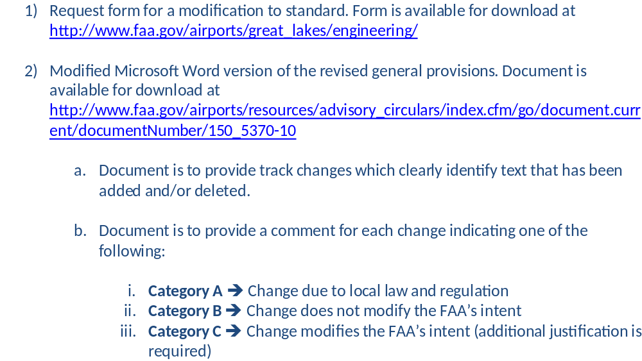
Request to Modify General Provisions
Notes:
If an Airport Sponsor is requesting to modify the general provisions, the following is the process
The airport sponsor is to submit the change utilizing the Great Lakes Region modification to standards form. The airport sponsor, not their consultant, is to sign and date the completed form.
The FAA requests that a modified word version is provided for review, by the use of track changes.
For each change, the sponsor must indicate which category it falls under.
Category A are changes made to make them consistent with local law or regulation.
Example: Modifications to the DBE section, based on local law.
Category B are changes made, but does not modify the FAA’s intent.
Example: Cement is replaced with Portland Cement Concrete.
Category C are changes made, which modifies the FAA’s intent. This requires additional justification.
Example: Modifying the definition of a major contract item from 20% to 25%
Requests are submitted to the Airports District Office for initial review.

Slide 29
Presentation Objectives
Describe the FAA’s role in reviewing Airport Sponsor’s construction specifications
Discuss the different ways to construct airports with federal funding
Describe the FAA’s expectations for modifying FAA standards
Modifying General Provisions
Notes:
We have discussed a lot of material in this presentation. First, we looked at the FAA’s role in reviewing Airport Sponsor’s construction specifications, next we discussed the different ways to construct airports with federal funding, then we learned the FAA’s expectations for modifying FAA standards and finally we discussed modifying general provisions.
More than half of all AIP funds go toward constructing or rehabilitating runways, taxiways, and aprons. FAA pavement standards help protect this investment by ensuring pavements last as long as possible with the least amount of maintenance. We have and we will continue dedicating research and development in pavement design and construction. The FAA strongly encourages airports to utilize an unmodified FAA specification, but we understand each airport has unique situations which may warrant a modification. I hope this presentation has given you a better understanding of this process.

Slide 30

Ryan Bale, P.E.
Program Manager
FAA – Dakota-Minnesota ADO, Bismarck Office
Email – Ryan.Bale@faa.gov
Phone – 701-323-7390

