Slide 1
NEPA: Thoughts to Consider to Ensure a Successful Project
Presented by:
Sheri Lares
FAA Dakota-Minnesota ADO
November 2016

Slide 2
Discussion Outline
Project Boundaries and Definitions
Preliminary Engineering Design (PED)
Environmental Scopes of Work (SOW)
Environmental Commitments
Environmental Updates

Slide 3
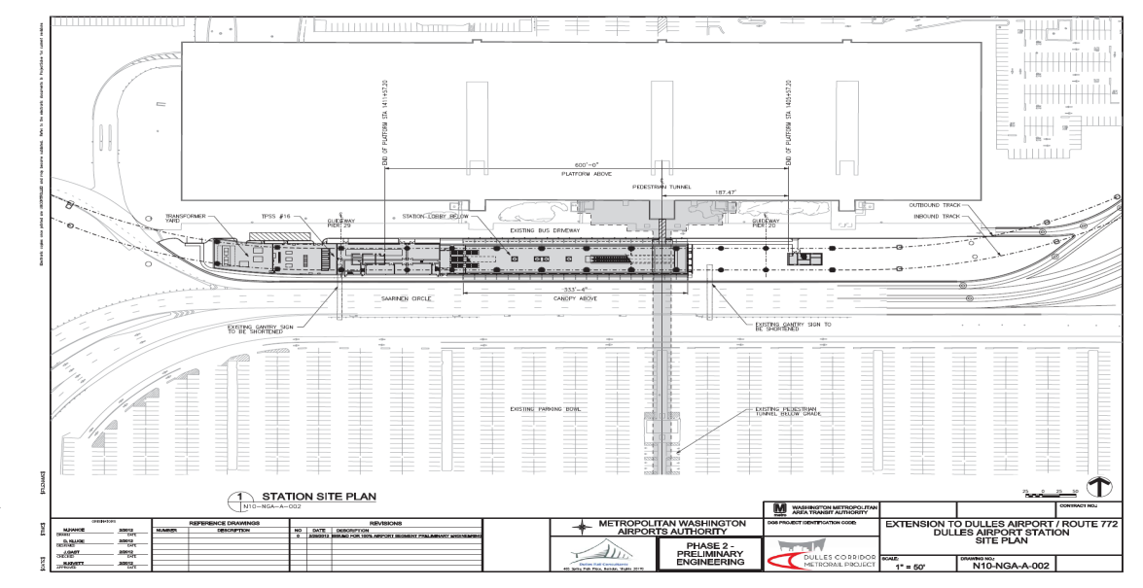
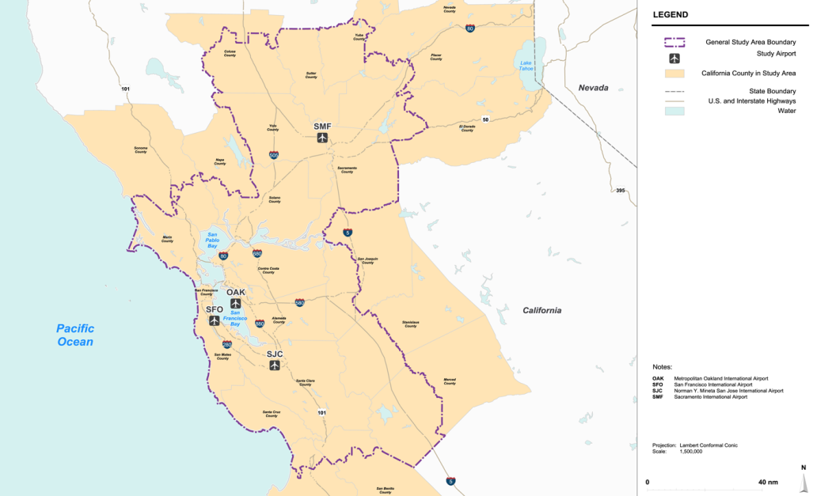
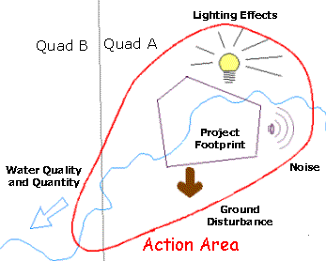
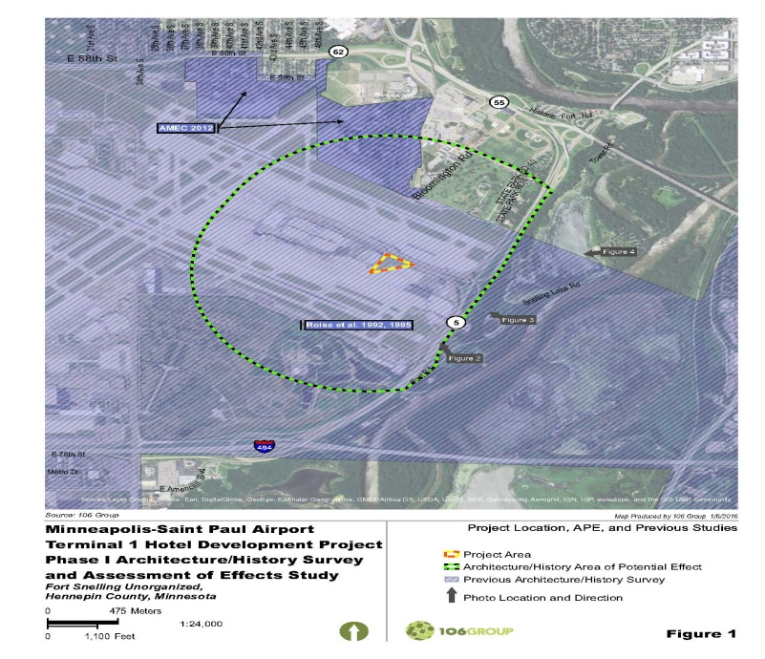
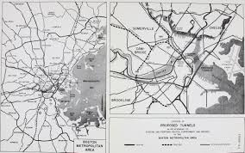
Project Boundaries?
Notes:
There is a national initiative to improve the quality of NEPA documents and to effectively communicate to the public. In the past, and still today, the documents are too large, complex, and lack editorial quality and technical validity, and unfortunately are incomprehensible to the average citizen.
Today we are using this opportunity to focus on a few items that we can become more effective in communicating information and satisfying legal requirements.

Slide 4
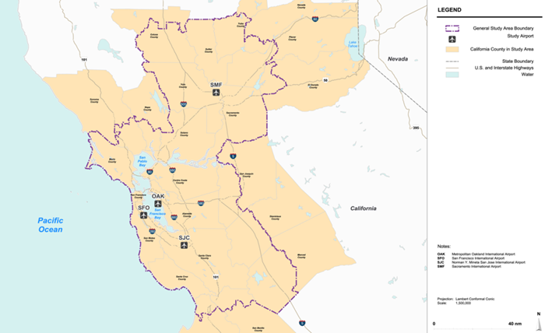
Why boundaries are SO important
Study area and resource area boundaries are one of the most common trouble spots related to the legal sufficiency of a NEPA document.
They are critical to the impact analysis yet often described vaguely or without clear rationale.
The study area is sometimes defined by limited boundaries (property), yet the project impacts extend over a wide geographic area or include different and overlapping environmental resource boundaries.

Slide 5
Boundaries - continued
The geographic extent of the affected environment may vary for each resource analyzed.
Appropriately established study and project area boundaries should take into account environmental resources and analysis of impacts to each resource.
Think it through – it is a decision in planning and environment that can affect the project in design thru construction.

Slide 6
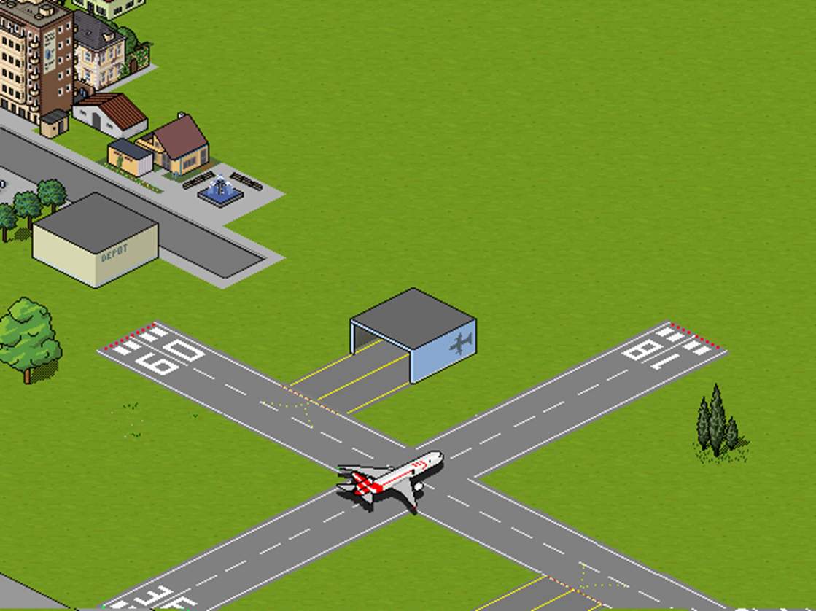
MANY terms used by MANY …
Study Area
Project Area
Limits of Construction
  Permanent
  Temporary
Grading Limits
Area of Potential Effect (NHPA)
Action Area (ESA)
Notes:
Often times the first thing practitioners want to complete is the scoping letters with the study area map. Be careful not to limit yourself to a study area defined by the property map if you have not thought it thru as it relates to the reasonable range of alternatives, resources and potential impacts.
Limits of construction includes perm and temp. Grading limits is very specific.

Slide 7
Methodologies
Identify the rationale for the definition of the study area and project area
  Generalized study area allows for the reasonable evaluation of potential impacts
  Where possible use a single description for the general project area rather than a separate one for each alternative
Be Strategic!
Notes:
Defined methodologies, including the rationale for the definition of the study area, enhances the credibility of the NEPA document by helping the reader to see the careful systematic process that was used.
Geographic extent of some of these boundaries may well go beyond airport boundary.

Slide 8

Area of Potential Effect (APE)
The National Historic Preservation Act of 1966 defined, the area that may be affected by the undertaking, including direct effects and indirect effects (such as visual and audible changes) which may affect the character and setting of those properties eligible or on the National Register of Historic Places.

Slide 9
APE and Traditional Cultural Places (TCPs)
It is very difficult to determine the boundaries of TCPs
Limits of the APE may extend far beyond the artificial boundaries of a TCP
Categories of effect (36 CFR Part 800) may not encompass all the potential effects to a TCP
Notes:
TCP is a property, a place, that is eligible for inclusion on the NRHP because of its association with cultural practices and beliefs that are (1) rooted in the history of a community, and (2) are important to maintaining the continuity of that community’s traditional beliefs and practices.
The first step in documenting the TCP is to identify the tribes and the traditions that are associated with the properties. This is done through literature search, by a reconnaissance of the study area, and through consultation with tribal representatives. Working together with the Tribes and archaeologists, the APE can then be identified.
Defining the boundary of a TCP can create considerable problems. In case of historic district in Northern CA much of the district is quiet and utilized for traditional uses such as extensive use of natural landscape for medicine making. If these boundaries were based on those factors, the area would take in a large portion of the northern coast range of the northern CA.

Slide 10

Action Area
The Endangered Species Act of 1973 defines all areas to be affected directly or indirectly by the action and not merely the immediate area involved in the action (50 CFR 402.02).
The analysis is not limited to the “footprint” of the action nor is it limited by the Federal agency’s authority.
Notes:
There may be lighting or water issues that impact species off of airport. Think broadly for action area.
Ground disturbance includes all elements of construction including haul roads, batching plant, etc.

Slide 11
Action Area - continued
USFWS recommends illustrating on a map the following areas:
  Ground disturbance
  Changes in water quality and quantity (surface and ground)
  Air quality impacts
  Lighting effects
  Noise disturbance
These affected areas combined is the action area when analyzing impacts to Federally-listed species.
Notes:
Ground disturbance includes all limits of construction.

Slide 12
Environmental Resource Analysis Boundary
Step 1 - Each environmental resource should have its own “base” map
Step 2 - Identify Effects
  Direct and Indirect
  Cumulative
Step 3 – Graphically illustrate the extent of the impact analysis boundary
Notes:
Lastly, 1050 states that the geographic extent of the affected environment may vary for each resource category analyzed in NEPA and the combination of all study areas represent the potential impact area for EJ because impacts may be realized in conjunction with impacts to any other impact categories.

Slide 13
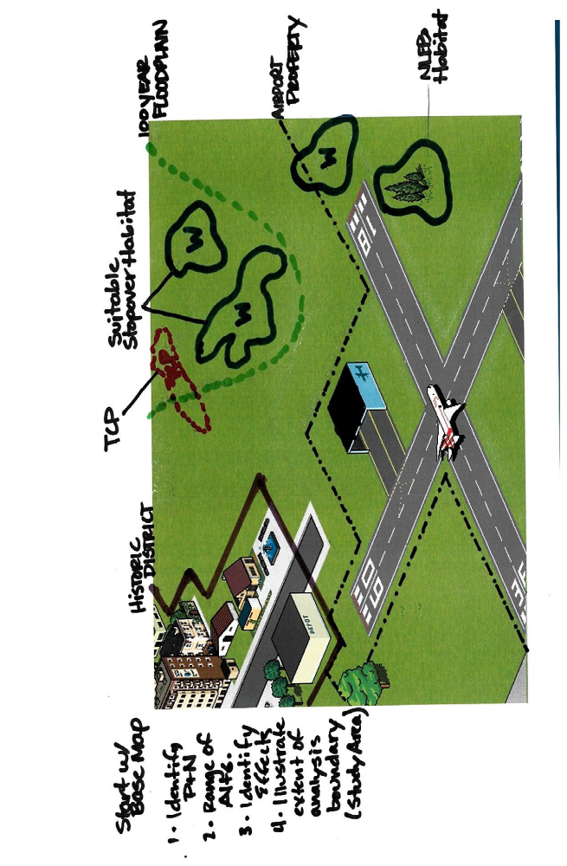

Slide 14
Design Considerations in Environmental
How much design to do in Environmental?
  Commensurate with Impacts
  FAA needs enough design to be able to make a valid environmental finding
Why design during environmental?
  Mitigation Sequencing and/or Mitigated FONSI
    1050.1F 2-3.6 & 4.4
  Cultural Resources
  Wetland Impacts
  Endangered Species: Tree Removal (Bats)
Notes:
Since the FAA issues funds for a local project, our expenditure of funds is considered a federal action, therefore affording the FAA a responsibility to over see compliance with environmental laws prior to the project being built.
10501.1F 2-3.6 & 4.4 discuss incorporating design into enviornmental to reduce impacts. This is needed for sequencing to avoid, minimize and mitigate. It is also used to reduce the NEPA documentation from a possible EIS to an EA. Further design would be undertaken to achieve a mitigated FONSI.

Slide 15
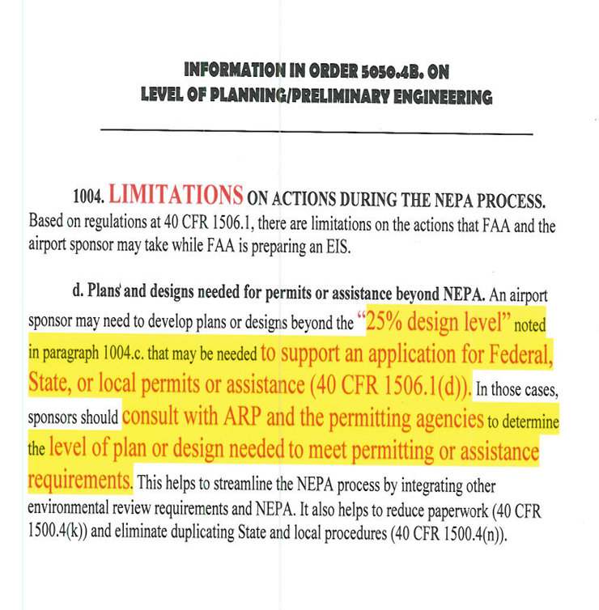
Design Considerations in Environmental
May need at least 25% design
    Conduct Preliminary Engineering Design (PED) in environmental phase of project
    5050.4B: 1004
    Permitting may accept more than a 25% design
Notes:
Problem: there are incomplete environmental submittals, especially 11th hour type of projects that have sat. We may need more design and survey work completed earlier prior to a design and construction grant.
Per 5050.4B, 1004: Designing beyond 25% may viewed as predecisional. Designing beyond 25% sends a message that FAA is prejudging the proposed project’s merits before it completes NEPA. The FAA will not fund actions that would bring into question its credibility or its public perception of FAA objectivity and impartiality during the NEPA process.
After NEPA, permitting phase of project may require more than a 25% design.

Slide 16
Other Design Considerations in Environmental
Airports GIS
  Tree removal
Scope your projects accordingly
Design helps avoid, minimize, and then mitigate!!
Notes:
Design helps avoid, minimize then mitigate. There is a sequence that will lead you to an alternative(s).

Slide 17
Problem(s)
FAA purview as lead Federal Agency
  Responsibility to comply with law
Environmental Scopes of Work (SOW)
  Need to answer questions that need to be answered
  106, ESA, P&N, 404, 401, 402 etc.
  Tribal
Notes:
Properly vetted Environmental SOW can stave off many issues that could occur later on
Good SOW helps answer questions in environmental

Slide 18
Tool: Environmental Scope of Work
Environmental Scope of Work (SOW)
  Justification
  Purpose and Need
  Preliminary Engineering Design (PED) & Surveys
  Alternatives
  Potential Environmental Constraints
  Coordination
  Conceptual Mitigation
  Public Comment
Notes:
Each of these points need to be covered in a SOW to help promote an adequate environmental document
Talk about each one.

Slide 19
SOW
Justification
  Nail down the project justification
  The difference between a difficult and a relatively straightforward environmental process is directly related to how good a job you do in nailing down the justification. The “justification” will also be used later on to form the foundation for your “Purpose & Need” statement in your environmental review.
  The “justification” sets up a compelling argument as to why your project should be considered for funding.
  Documented
  Detailed
Notes:
Justification should be well established/defined before entering into the environmental….should be 80% flushed out.
For Justification:
What’s driving the need for the improvement?”
“Does a prospective ‘fix’ to the problem make sense, and is it realistic?”
“Can you convince others of the reasons why the problem needs to be fixed?”

Slide 20
SOW
Purpose and Need
  What’s the problem?
  How do we solve it?
  Goals and Objectives?
Notes:
Why, why here, why now

Slide 21
SOW
Preliminary Engineering Design (PED)
  If we know we may have significant impacts to resources then conduct PED during environmental
  No more guesswork
AGIS
Surveys
  Wetlands
  Endangered Species
  Cultural Resources
  Others

Slide 22
SOW
Alternatives
  Figure out the workable options and alternatives to help you achieve your development plans
  Can the site accommodate your proposed solution(s)?
  Does a prospective ‘fix’ to the problem make sense, and is it realistic?”
Environmental Constraints
  Alternatives to achieve the Least Environmentally Damaging Practicable Alternative (LEDPA)
Notes:
Alternatives development is linked to objectives per our previous slide
If good planning has been done, an array of alternatives should already be identified
Use objectives from purpose and need to ensure the alternatives are applicable.

Slide 23
SOW
Coordination
  Communicate to heighten the agency decision-maker’s confidence in the project that you are considering
  “Can you convince others of the reasons why the problem needs to be fixed?”
  Early and often
  Scope with outside agencies
    Seek input to incorporate their concerns/recommendations
Public Comment
Notes:
Helps assist in scoping of environmental

Slide 24
SOW
Conceptual Mitigation must be identified in an environmental Scope of Work
  FAA Order 5050.4B Chapter 7(g)
  Reduces risks/uncertainties
  Helps FAA know project can be built
Conceptual Mitigation can include anything that warrants it (404, 106, 402)
Notes:
We need enough information for us to make a decision. We need to understand and know the mitigation, if any, involved.
Conceptual measures are preliminary, qualitative explanations of each mitigation measure the sponsor develops in consultation with the responsible FAA official and expertise or jurisdictional agencies. These explanations should describe each measure’s benefits (Order 1050.1E, paragraph 405g) by noting how the measure would avoid or reduce the adverse environmental effects.

Slide 25
SOW
Conceptual Mitigation cont.
  Wetlands
  type, impacts
  Mitigation
Delineation Requirements
  Only good for 5 years
  Delineations are required if wetlands present on site
    Helps inform alternatives analysis
Notes:
Delineation requirement differences between ND and MN. Speak to respective states and use of 87 Manual Update

Slide 26
Significance of the SOW
Take Away Message:
  SOW sets a project up for better success
  Coordination: Early and Often
  Open Communication
  Interdisciplinary team. Coordination between FAA and your own teams internally

Slide 27
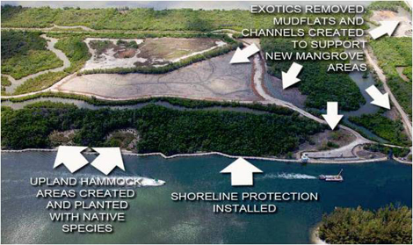
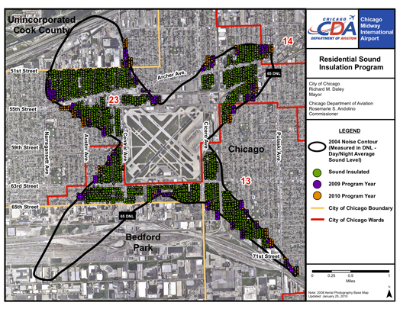
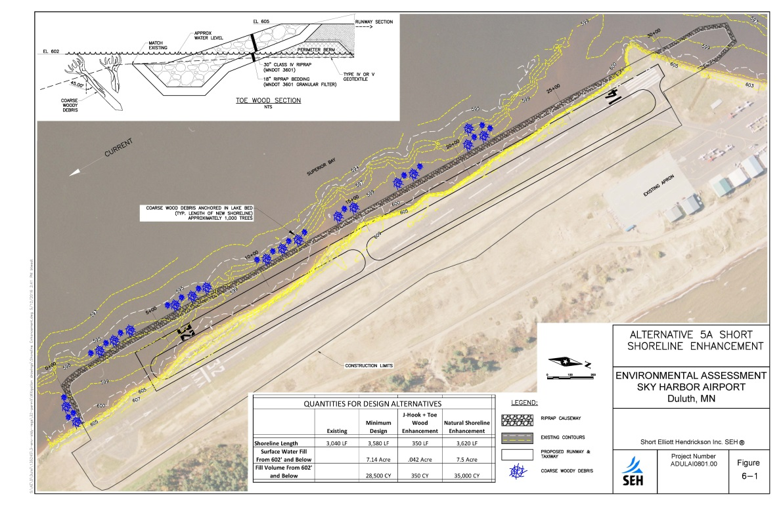
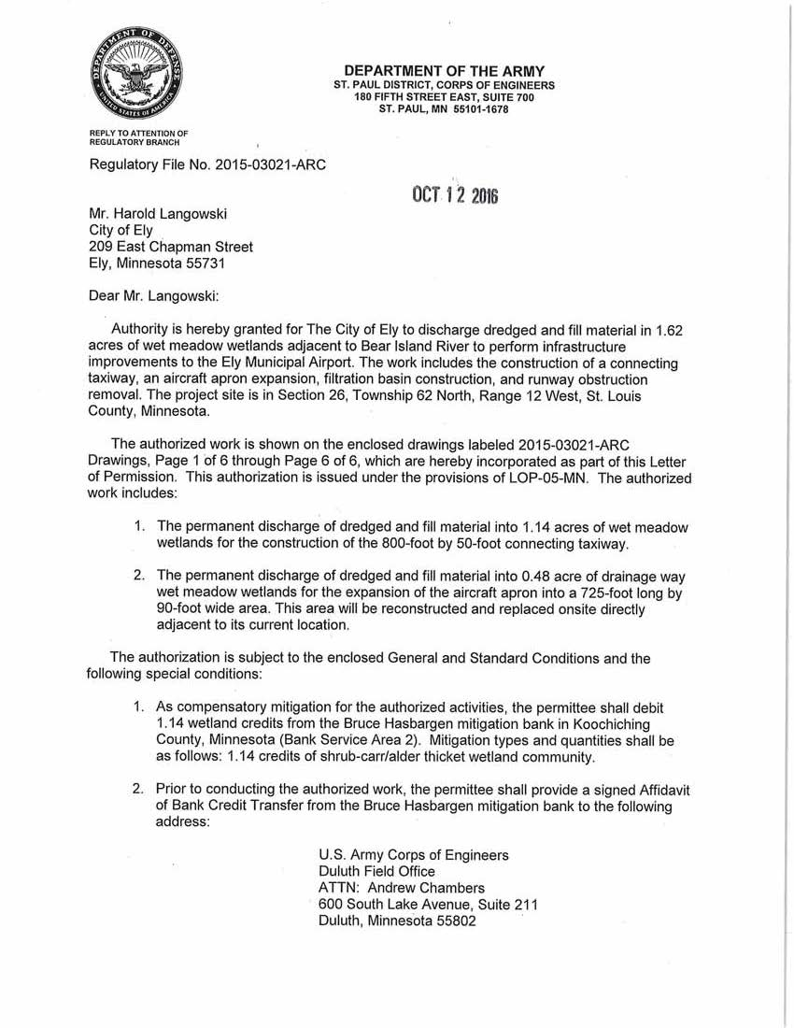
Environmental Commitments
Notes:
Environmental commitment includes any action that:
- is intended to avoid, minimize, or mitigate environmental impacts a project and
- is required to be implemented as a condition of project approval,
- or has been committed to by the project sponsor as part of the environmental review process.

Slide 28
Environmental Commitments – Why Do We Do It?
The consultation process may identify measures to avoid, minimize or mitigate impacts during NEPA.
We commit to mitigation measures to support a mitigated FONSI so as to complete the review of potentially significant environmental impacts without preparing an EIS.
We commit to mitigation measures considered as alternatives in an EA or EIS so as to achieve an environmentally preferable outcome.
Special permit conditions may be identified during the permitting process.
Notes:
Commitments arise out of various documents and at various stages of the environmental process, whether it be in the project development phase or the design/permitting phase. Some examples include:
NEPA documents(CE, EA//FONSI, EIS/ROD)
Section 106 memorandum of agreements
Biological Opinions/incidental take statements issued by usfws during the section 7 of the ESA consultation process Section 404 permit issued by the USACE under the clean water act Other state, regional, and local permits
Why do we do it - READ BULLETS

Slide 29
Environmental Commitments - How Do We Do It?
Identify environmental commitments in NEPA document
Implement special provisions or notes in the construction plans to reflect the commitments or permit conditions
Cross reference commitments with other documents (ensure that they do not contradict)
Create and document a process for tracking and implementing commitments
Notes:
The environmental process for a major project could result in upwards of 100 commitments. Some commitments may be defined very specifically or may be defined only as a broad concept that you have to incorporate into your project to meet the intended goal. There may be situations where commitments may conflict or overlap from different laws or agency requests and at other times they may be unclear, inconsistent or contradictory. It is key to have a system in place to review and track the environmental commitments early in the process and negotiate with the agencies to ensure that any issues get resolved early.
Now, how we do it- READ BULLETS
Key items to get across-
1-develop section in NEPA document that identifies commitment 2-carry commitments into decision document 3-identify in design plans, utilize a sheet specific to commitments in the plan set
4-for large scale projects, a spreadsheet or matrix is helpful to build upon between phases that identifies critical or time sensitive items such as commitments that affect design, construction phasing, staffing, time restrictions (such as migration season, bat maternity season, spawning season, etc.)

Slide 30
Modifications
It is essential to understand why commitments were adopted initially
If conditions or project changes that result in a modification to a commitment or project boundary, additional coordination is warranted in a number of areas:
  NEPA
  Agency Consultation
  Permit Modification
  Plans
  Contract Documents
Notes:
One of the key elements when working in NEPA is having an interdisciplinary team comprised of individuals with various expertise that have depth and range of knowledge in all phases of a project. This includes environmental documentation, design, permitting, construction, and maintenance.
This is key to understanding why the commitments were adopted initially.
There are times when you may find that a environmental commitment cannot be implemented during construction due to the design constraints. This may result in Changes to the NEPA document, requires additional consultation, modification to permits, addendum to the plans, or contract documents. Therefore the IDT should:
1-review scoping letters early with FAA 2-coordinate with agencies and FAA to seek clarifications, negotiate if necessary etc. 3-consider implications to the design, construction and maintenance of the project 4-ensure that commitments that require additional work during construction should be incorporated into project, such as bird surveys and tribal monitoring prior to and during construction 5-be clear as to who is responsible to comply with the commitment (sponsor/faa or contractor)

Slide 31
NEPA Commitments - examples
Avoidance Areas must not be disturbed and shall be fenced prior to commencement of construction (Cultural Resources)
The Airport Action Area is within the migration corridor of the endangered whopping crane. If species are observed, construction shall cease until the disturbance risk is minimized. If utility lines are moved, installed, or raised, line markers will be added at a ratio of 2:1 (T&E Species)
Tree removal will occur outside summer roosting season for the NLEB (4/1 – 9/30) (T&E Species)
Construction or demolition activities in designated waters (i.e. culverts or drainage work etc.) shall not occur during the spawning season (4/15-6/1) (T&E Species)
“x” acres of impact to natural wetlands (natural/jurisdictional and natural/nonjurisdictional), regardless of size, as well as “x” acres of impacts to artificial/jurisdictional wetlands (greater than 0.10 acres) require mitigation. Therefore, mitigation will occur offsite at an approved mitigation site or bank, or by in-lieu fee agreement (identified) (Wetlands)

Slide 32
Oversight/Quality Control
If commitments are not documented or monitored to ensure that the commitments were implemented or effective, it may result in:
  Failure to advance NEPA’s purpose of ensuring informed and transparent environmental decision-making
  Undermining the integrity of the NEPA review
  May jeopardize federal funds
  Compliance Issues
Notes:
Key item to get across
The project sponsor and FAA remains ultimately responsible for ensuring that the commitments are implemented. Therefore, it is necessary to provide oversight of the contractor to ensure compliance with the commitments during construction.
Commitments should be CIP. Need line item in CIP to pay for it.
Compliance with FAA grant assurances.

Slide 33
Successful Implementation Practices
NEGOTIATE with agencies on proposed commitment(s) to ensure it is feasible and prudent
INCORPORATE commitments into NEPA; subsequent funding, permitting, and other agency approvals are conditional on commitment compliance
COMMUNICATE the commitments to project engineers to incorporate into the design, construction and maintenance
TRACK commitments during plan completion to ensure they are incorporated into the plans and contract documents as intended
COMPLIANCE with commitments (construction and maintenance)

Slide 34
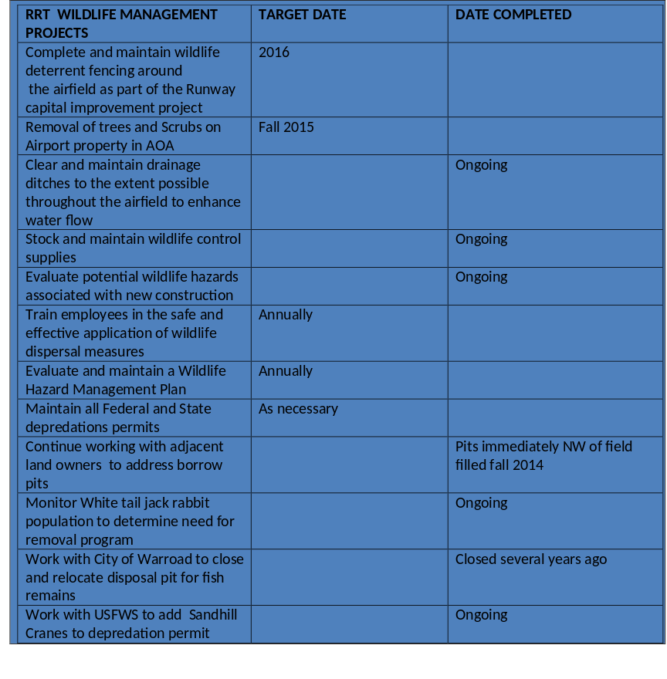
Environmental Updates
5050.4C Release
Wildlife Hazard Management Plans (WHMP)
  Recommended actions in WHMP may need further environmental review
  Talk to ADO Environmental Protection Specialist
Notes:
State FRN for wildlife and environmental expired late November.

Slide 35

Issue:
Recent litigation in New York brought to light potential issues with WHMPs.
FAA realized it may need to:
  clarify Policy 92 and associated text in Order 5050.4,
  clarify the appropriate process for compliance with NEPA and other special purpose laws prior to implementation of WHMP measures.

Slide 36

Summary of Snowy Owl litigation:
Lawsuit against USDA and USFWS by Friends of Animals after JFK used lethal take to remove 3 snowy owls from the airport because they were considered a serious hazard to aircraft and human safety.
The USDA and FWS authorized a Gull Hazard/Bird Hazard Reduction Program at JFK following the preparation of an EIS.
“Port Authority 'wildlife specialists' hunt snowy owls at New York City's airports”….Daily News

Slide 37
Summary of Snowy Owl litigation:
Friends of Animals claimed that the Bird Reduction Program and EIS didn’t include, among other things, reasonable alternative measures to mitigate hazards to aircraft by the snowy owl; therefore, violating NEPA.
Friends of Animals claimed FWS also violated the MBTA by issuing an overly broad depredation permit that doesn’t provide valid justification for lethal take of protected species.
The District Court disagreed with Friends of Animals and found that neither NEPA nor MBTA were violated.

Slide 38
What is HQ doing regarding 92?
Policy 92 addresses the applicability of NEPA to WHMPs
Redrafting Policy 92 to specifically note that each element of a plan needs to be reviewed for NEPA; even elements that don’t involve an ALP update or Federal funding.
NEPA review may be CATEX, EA or EIS.
Approval or partial approval letters

Slide 39
What could this mean?
Earlier engagement of EPS in WHMPs
Earlier identification of potential issues including T&E species
Earlier consideration of appropriate level of NEPA review
Consultation and Coordination in some cases
Partial or incremental approvals of WHMPs

Slide 40
Summary
Project work must stay in the box identified in environmental finding
If there is larger guesswork on impacts, PED should occur in environmental phase of project
FAA will be closely tracking environmental commitments made going forward. Do what you say you are going to do.
Changes to WHMP requirements coming in future

Slide 41

Questions?

